Slide 1

{
{
最简化雅思写作
新浪微博：@刘洪波-贵学

Slide 2
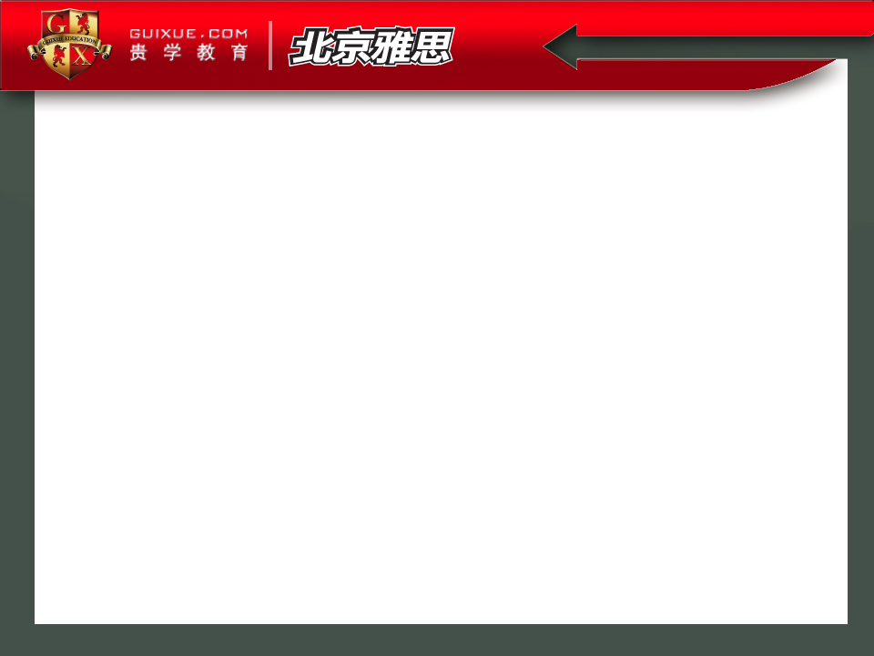
我看评分标准
为什么总是5分
从5到6
7分以上
15句思路框架介绍
V. 2篇范文解析

Slide 3
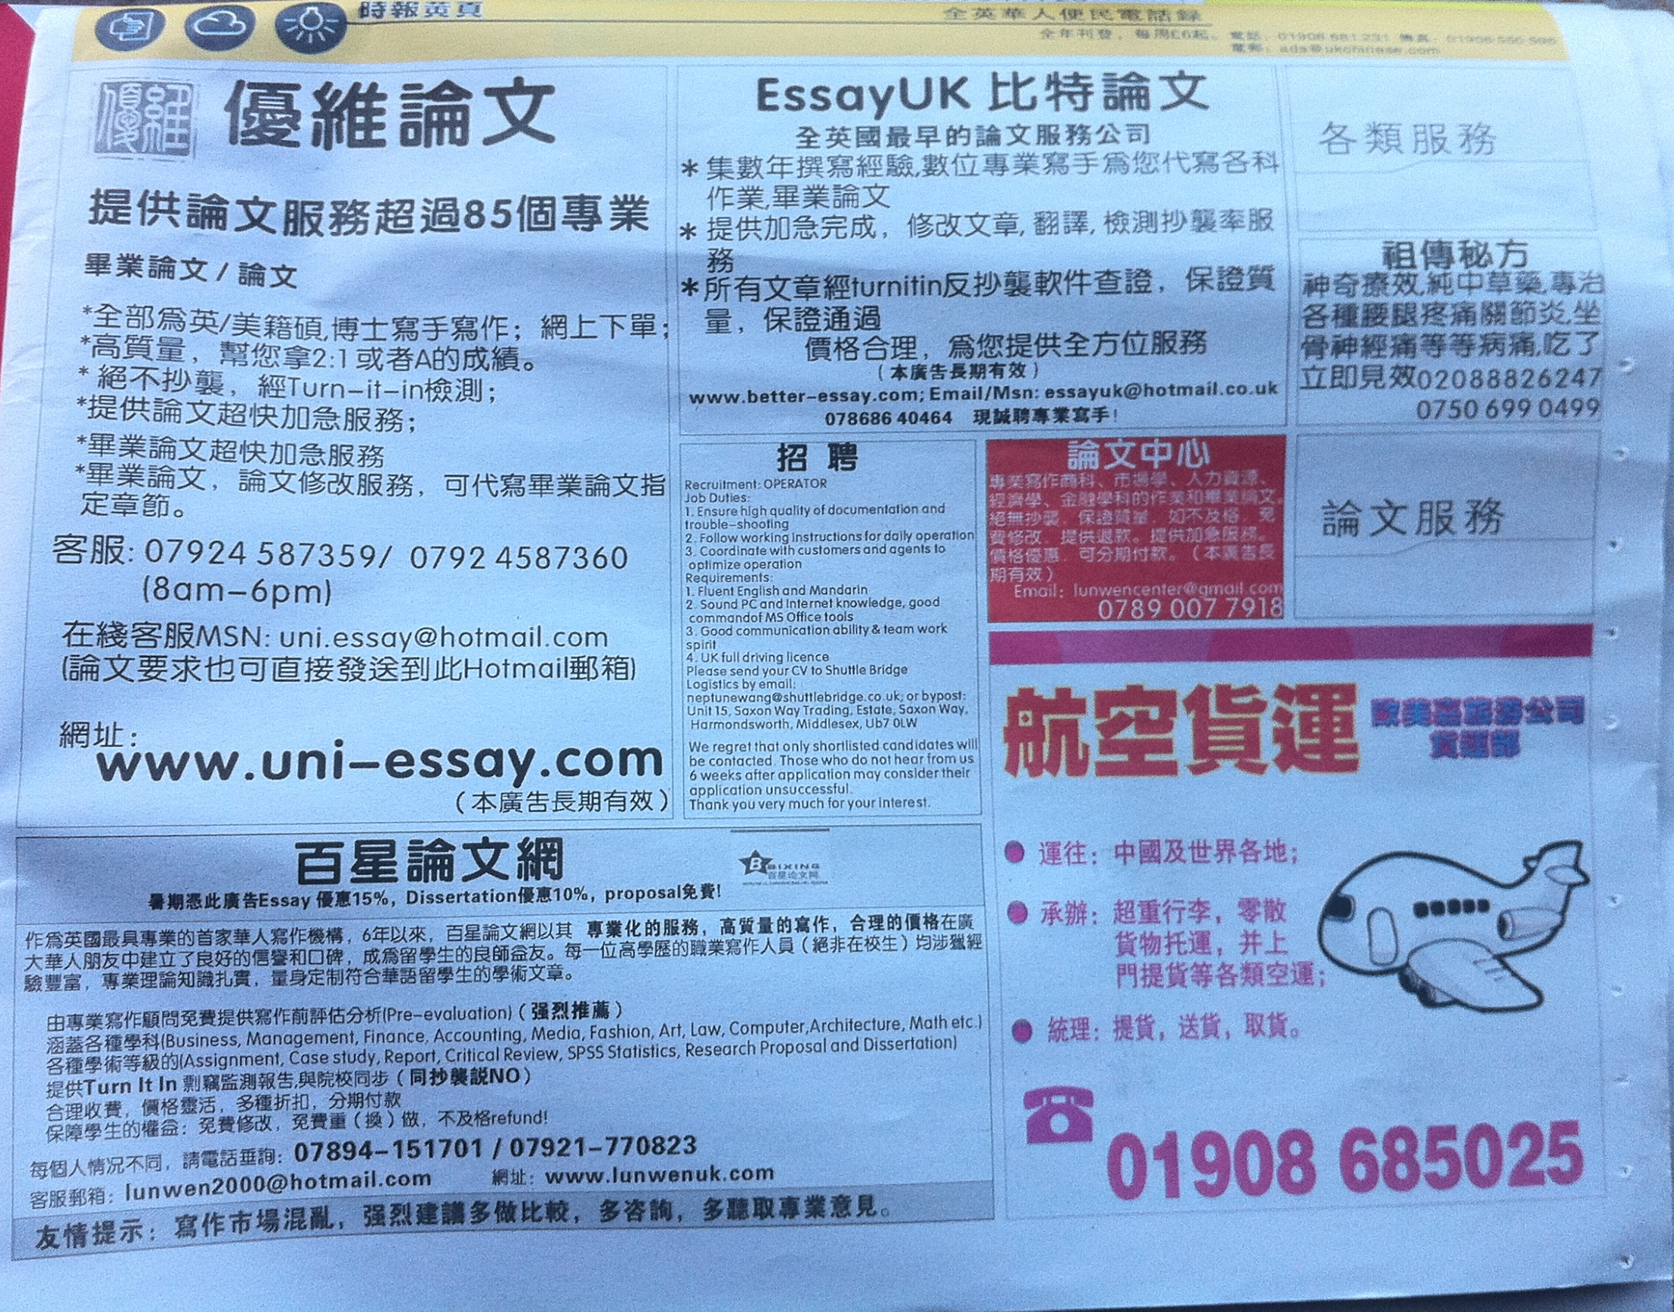
II. How to read faster
1. 物理疗法 NO SOUND
What a nice car!

Slide 4
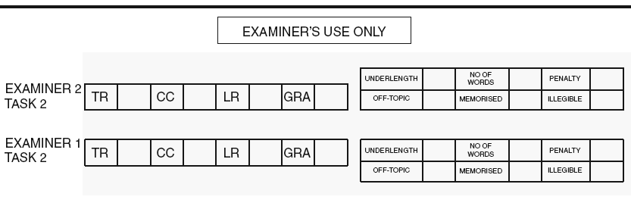
I. 我看评分标准

Slide 5
I. 我看评分标准
雅思作文四大评分标准
Task Response （任务回应）
Coherence and Cohesion（一致与连接）
Lexical Resource（词汇资源）
Grammatical Range and Accuracy（语法范围与正确性）

Slide 6
I. 我看评分标准
7

Slide 7
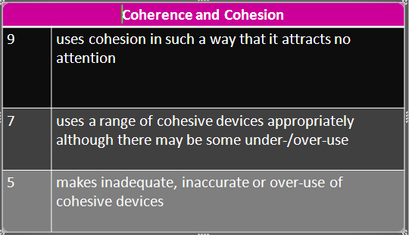
I. 我看评分标准

Slide 8
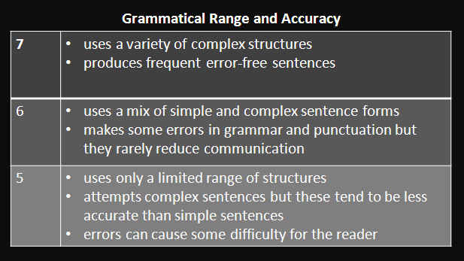
I.我看评分标准

Slide 9
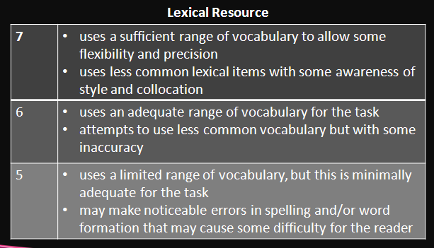
I.我看评分标准

Slide 10
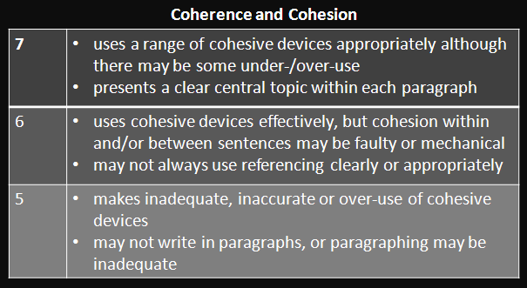
I.我看评分标准

Slide 11
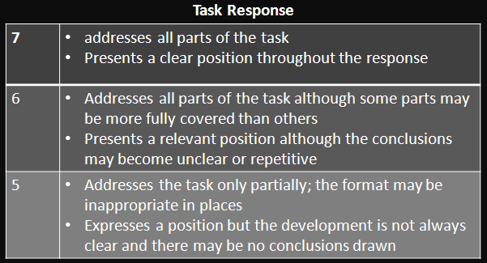
I. 评分标准的背后

Slide 12
I. 我看评分标准—结论
------------------------- #
---------------$---------------
------------------------#
-------------------------- $
#

Slide 13
II. 为什么总是5——还原雅思考官评分过程
《剑7》p169
Some people think that universities should provide graduates with the knowledge and skills needed in the workplace. Others think that the true function of a university should be to give access to knowledge for its own sake, regardless of whether the course is useful to an employer.
What, in your opinion, should be the man function of a university?

Slide 14
II. 还原雅思考官评分过程
What knowledge and skills should universities provide has been argued for many years. Some people think that the true function of universities provide knowledge for their own purpose, but nowadays, more and more people point out that universities should provide graduates with the knowledge and skills according to the workplace.

Slide 15
II. 还原雅思考官评分过程
The first reason for universities should provide these knowledge and skill is the students’ needs. Obviously, the most of the students go to university purpose of is to get some knowledge and skills which could make them have the ability to get a job. If a university does not provide these knowledge and skills, the students might not get a job and they would be very disappointed. As a result, the university would lose its students.

Slide 16
II. 还原雅思考官评分过程
Moreover, providing knowledge and skills needed in the workplace maks a university progress. The new skills and information always are initiated in the workplace, so focusing on the needs of the workplace the university could get sound strategies to do research and make it more mordenization.

Slide 17
II. 还原雅思考官评分过程
Lastly, providing these knowledge and sills could benefit our country which usually gives a financial support to universities. Having these knowledge and skills, students are more easy to get a job, and this can make our countries’ economy strong.
In conclusion, it can be said that providing the knowledge and skills which the workplace needs is every universities’ basic function. (232 words)

Slide 18
II. 还原雅思考官评分过程
The examiner’s comment:
SCORE: 5
This answer is less than 250 words and it does not address all parts of the question, so it loses marks.

Slide 19
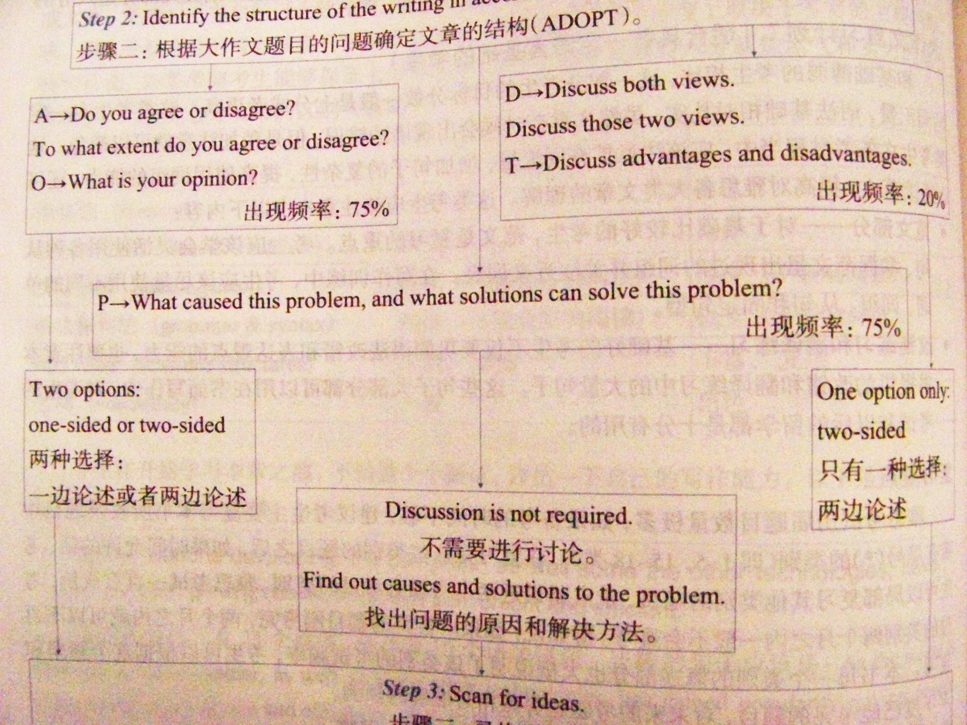
II. 还原雅思考官评分过程
The examiner’s comment:
SCORE: 5
This answer is less than 250 words and it does not address all parts of the question, so it loses marks.

Slide 20


Slide 21
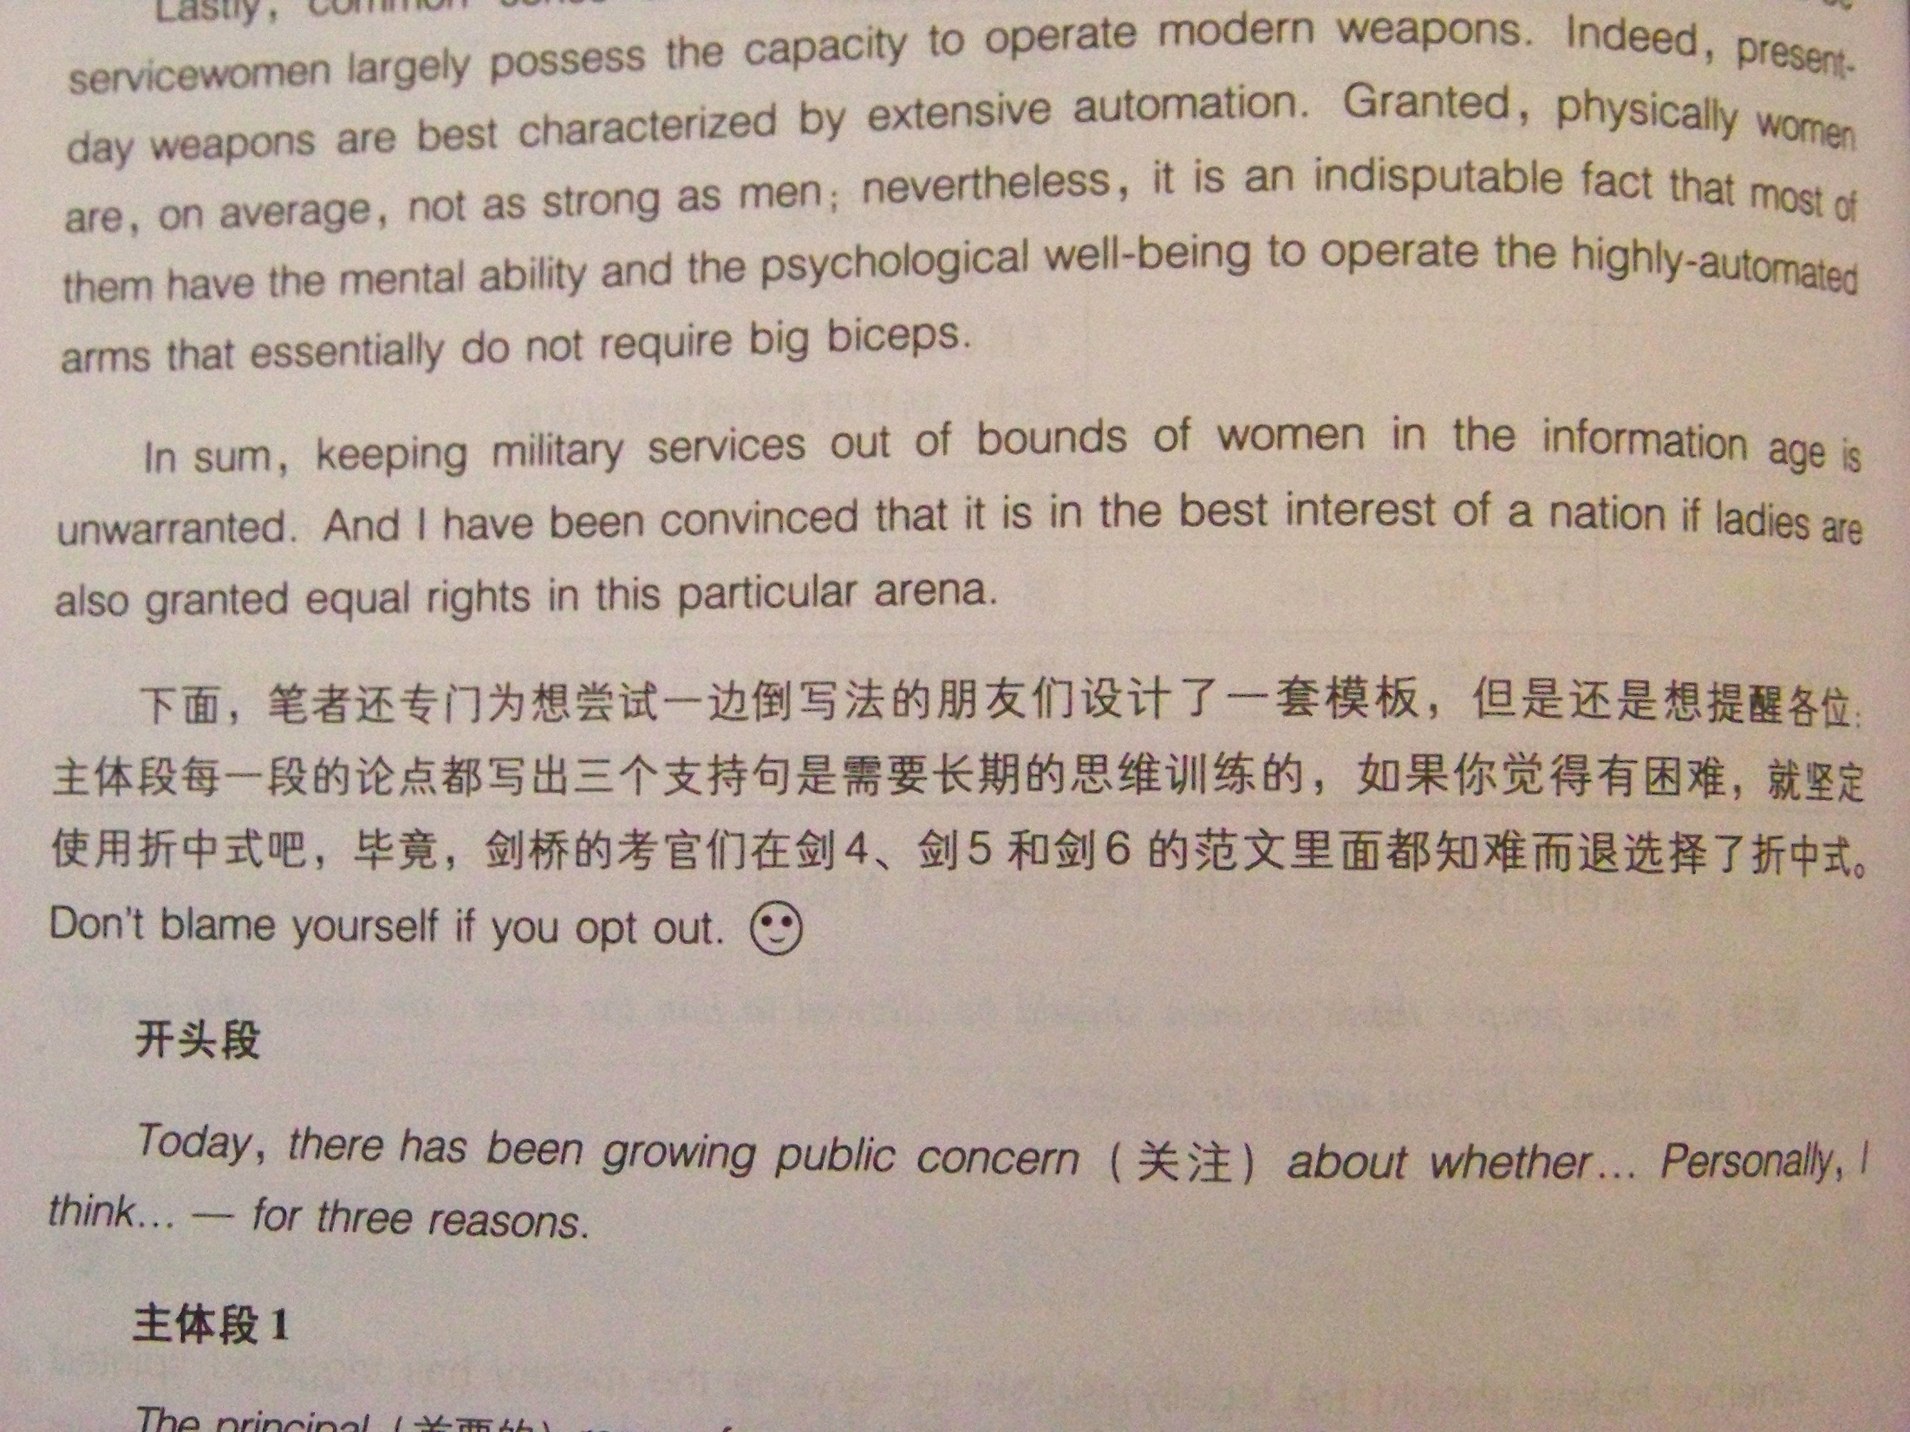
参考：
p144

Slide 22


Slide 23
The examiner’s comment:
Nevertheless, some relevant ideas and a position on the issue are presented. Ideas are organized and the structure of the answer is clearly signalled. There is some good use of linkers but there is also a lot of repetition due to inadequate use of referencing and substitution.

Slide 24
The examiner’s comment:
The high level of repetition [‘knowledge and skills’ is repeated nine times] also indicates limitations in range of vocabulary although, apart from language given in the rubric, there is just sufficient additional vocabulary for the task.
The answer includes attempts at complex sentence forms, but these are generally awkwardly phrased and tend to require some re-reading to understand. Nevertheless, there are examples of accurate complex structures.

Slide 25
（5+5.5+5+5.5）/ 4 = 5.25 ≈ 5.5
5.5 – 0.5 = 5

Slide 26
III. 从5到6
What knowledge and skills should universities provide has been argued for many years. Some people think that the true function of universities provide knowledge for their own purpose, but nowadays, more and more people point out that universities should provide graduates with the knowledge and skills according to the workplace.

Slide 27
III. 从5到6
The first reason for universities should provide these knowledge and skill is the students’ needs. Obviously, the most of the students go to university purpose of is to get some knowledge and skills which could make them have the ability to get a job. If a university does not provide these knowledge and skills, the students might not get a job and they would be very disappointed. As a result, the university would lose its students.

Slide 28
III. 从5到6
Moreover, providing knowledge and skills needed in the workplace maks a university progress. The new skills and information always are initiated in the workplace, so focusing on the needs of the workplace the university could get sound strategies to do research and make it more mordenization.

Slide 29
III. 从5到6
Lastly, providing these knowledge and sills could benefit our country which usually gives a financial support to universities. Having these knowledge and skills, students are more easy to get a job, and this can make our countries’ economy strong.
In conclusion, it can be said that providing the knowledge and skills which the workplace needs is every universities’ basic function. (232 words)

Slide 30
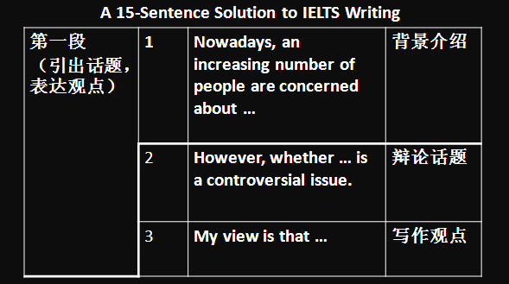
IV. 7分以上

Slide 31
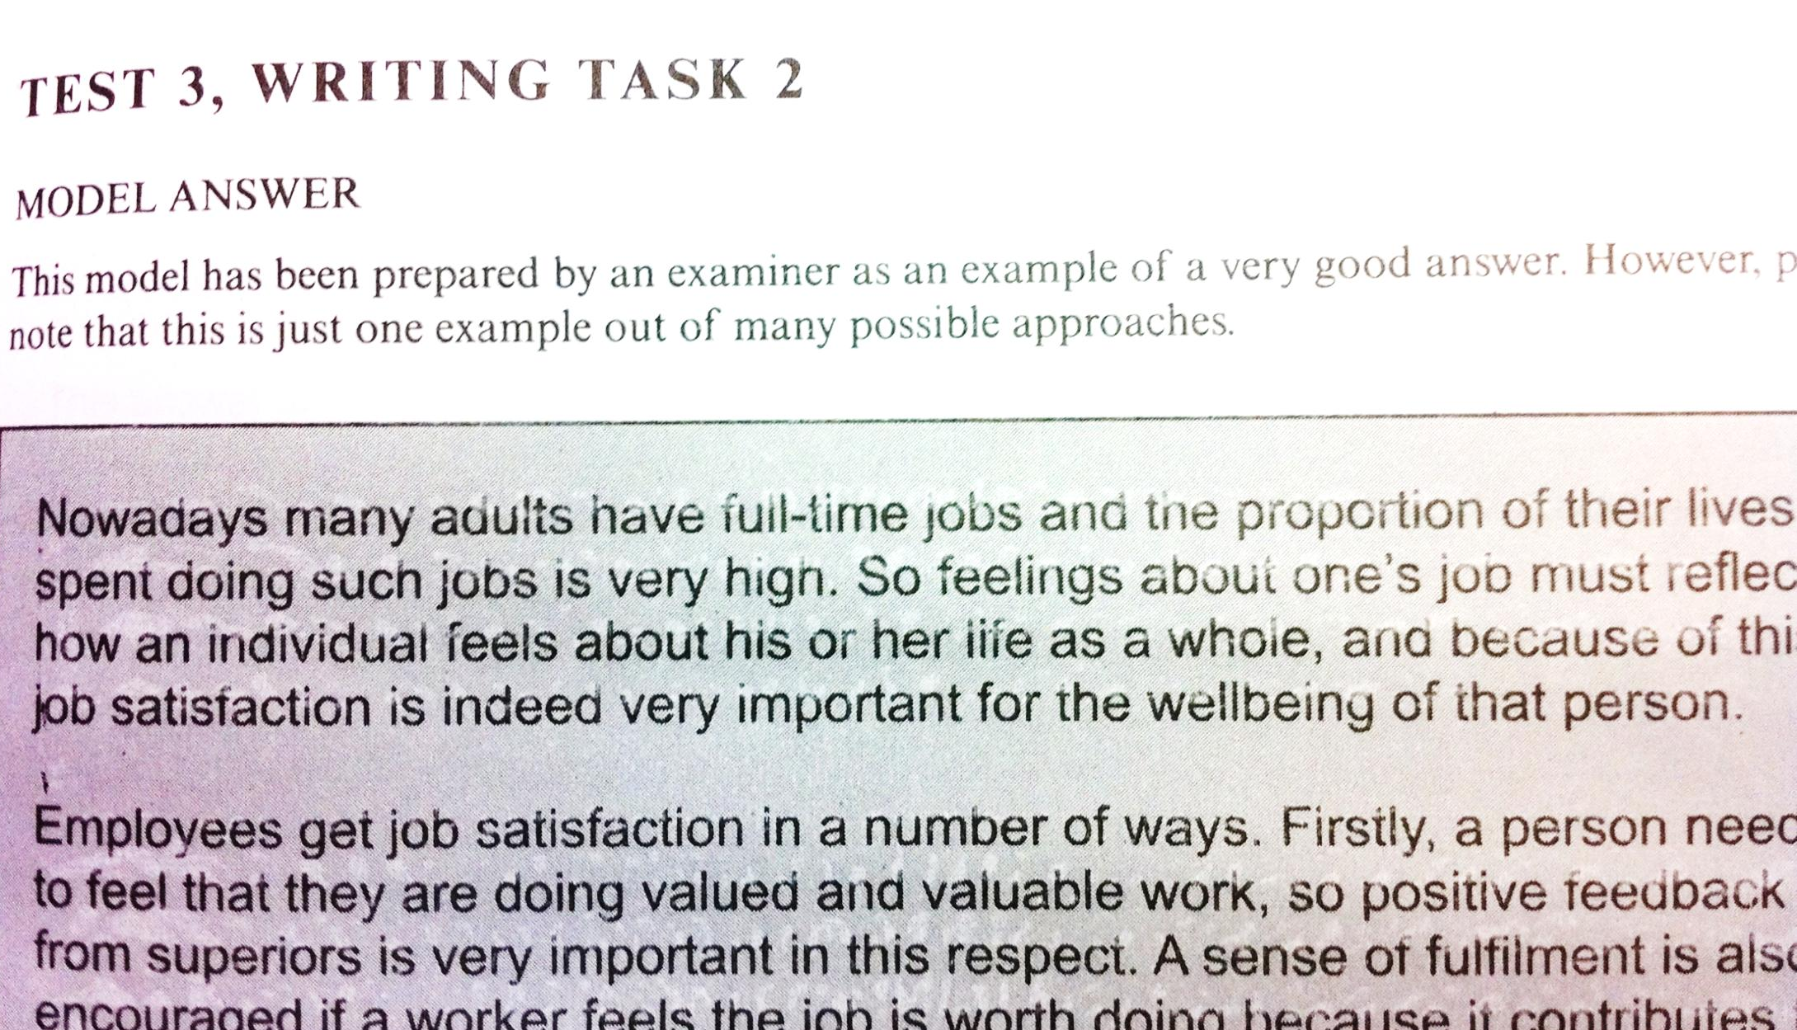

Slide 32
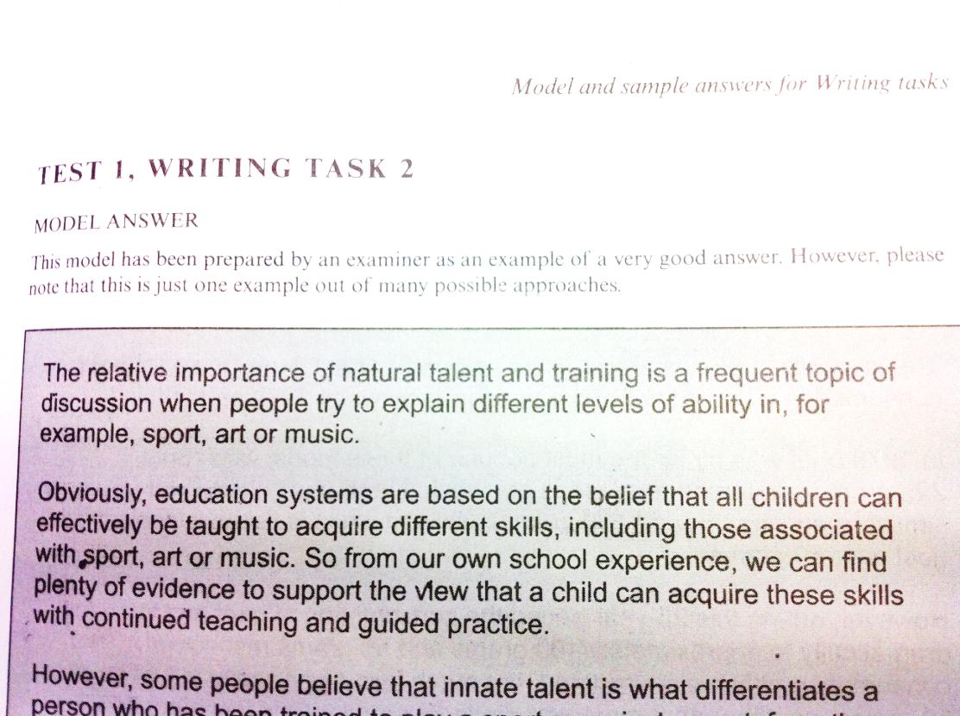

Slide 33
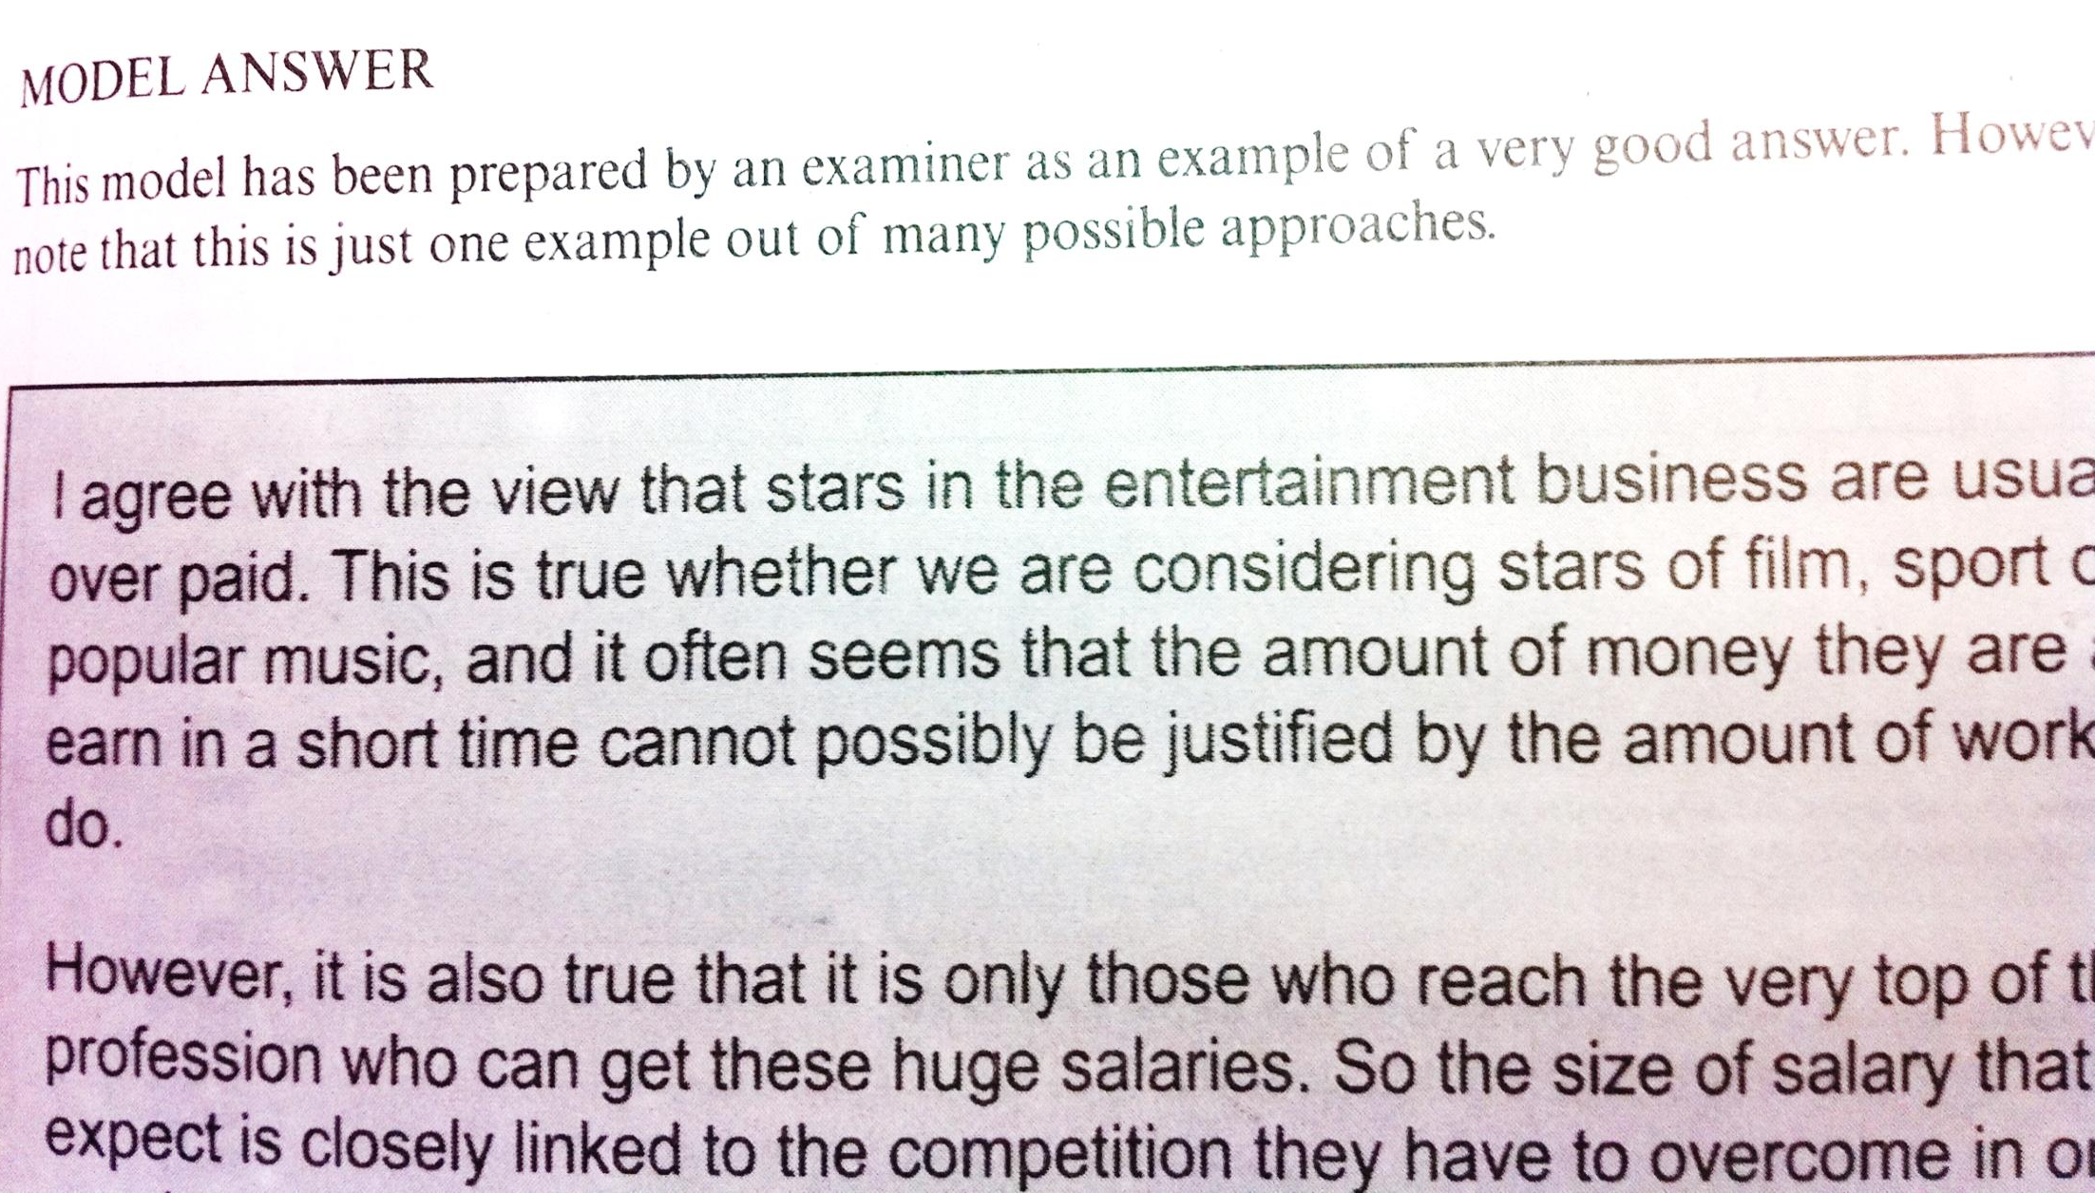

Slide 34
Harvey
之
雅思写作游泳理论
雅思写作境界理论

Slide 35
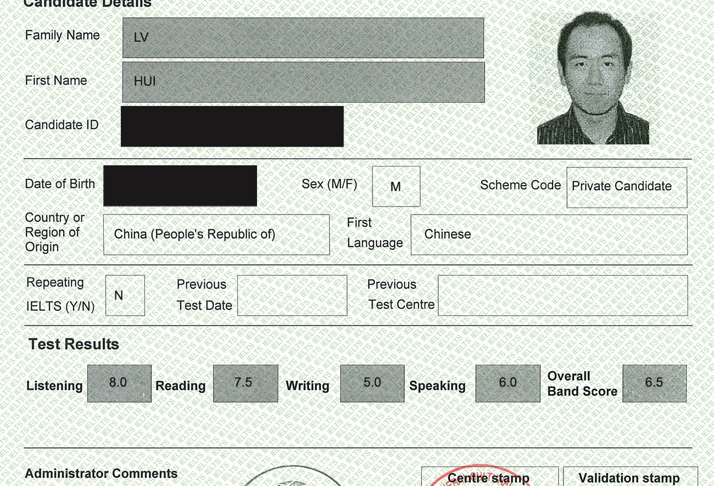

Slide 36


Slide 37
Some people think that parents should teach children how to be good members of society. Others, however, believe that school is the place to learn this.
Discuss both these views and give your own opinion.

Slide 38
A child’s education has never been about learning information and basic skills only.
It has always included teaching the next generation how to be good members of society.
Therefore, this cannot be the responsibility of the parents alone.

Slide 39
In order to be a good member of any society the individual must respect and obey the rules of their community and share their values. Educating children to understand the need to obey rules and respect others always begins in the home and is widely thought to be the responsibility of parents. They will certainly be the first to help children learn what is important in life, how they are expected to behave and what role they will play in their world.

Slide 40
However, learning to understand and share the value system of a whole society cannot be achieved just in the home. Once a child goes to school, they are entering a wider community where teachers and peers will have just as much influence as their parents do at home. At school, children will experience working and living with people from a whole variety of backgrounds from the wider society. This experience should teach them how to co-operate with each other and how to contribute to the life of their community.

Slide 41
But to be a valuable member of any community is not like learning a simple skill. It is something that an individual goes on learning throughout life and is the responsibility of every member of a society to take responsibility for helping the younger generation to become active and able members of that society.

Slide 42
WRITING TASK 2
You should spend about 40 minutes on this task.
Write about the following topic:
Individuals can do nothing to improve the environment; only governments and large companies can make a difference.
To what extent do you agree or disagree?

Slide 43
写作提纲
观点：每个人都能起作用
原因1：长期人类活动
原因2：个人能影响政府和公司的决定。
举例：如果人人不用一次性纸杯，就没有公司生产。

Slide 44
Environmental protection is one of the most important challenges almost every country is facing. However, whether only governments and big firms have resources and powers to preserve our environment is a controversial issue. My view is that every single citizen could also make a huge difference.

Slide 45
First, it is human activities that have the greatest impact on environment throughout the history. Both environmental pollution and conservation are the long-term process, and no single government or big company can meet this challenge alone. So, whoever created the problem should solve it; environmental protection needs every one of us to continuously participate in.

Slide 46
Moreover, the public’s wills and behaviours have a critical influence on government’s polices and company’s strategies. For example, if everyone says “no” to plastic shopping bags and paper cups, the companies that used to manufacture such products will switch to environmental-friendly substitutes in order to survive in the market.

Slide 47
That is not to say that governments and large companies can not positively contribute. Indeed governments can enact laws and introduce programs to raise the public’s low carbon awareness; companies can promote green products to change the public’s consuming habits. But they also need every citizen’s appreciation and support to bring good results.

Slide 48
In sum, no effort is too small when we are protecting environment! Meanwhile, local authorities and organizations must shoulder their responsibility to develop low carbon economy at the macro level. Only by doing so can we assure that we could hand this beautiful planet to our next generation, and the next generation after!
(260 words)

Slide 49



Where to find me?

Slide 50

不要像我当年一样选错功法啊！
加油吧，学弟学妹们，
学长只能帮你到这里了！
关掉话筒，
起身离去，
深藏功与名……

