Slide 1

{
{
雅思阅读真经

Slide 2
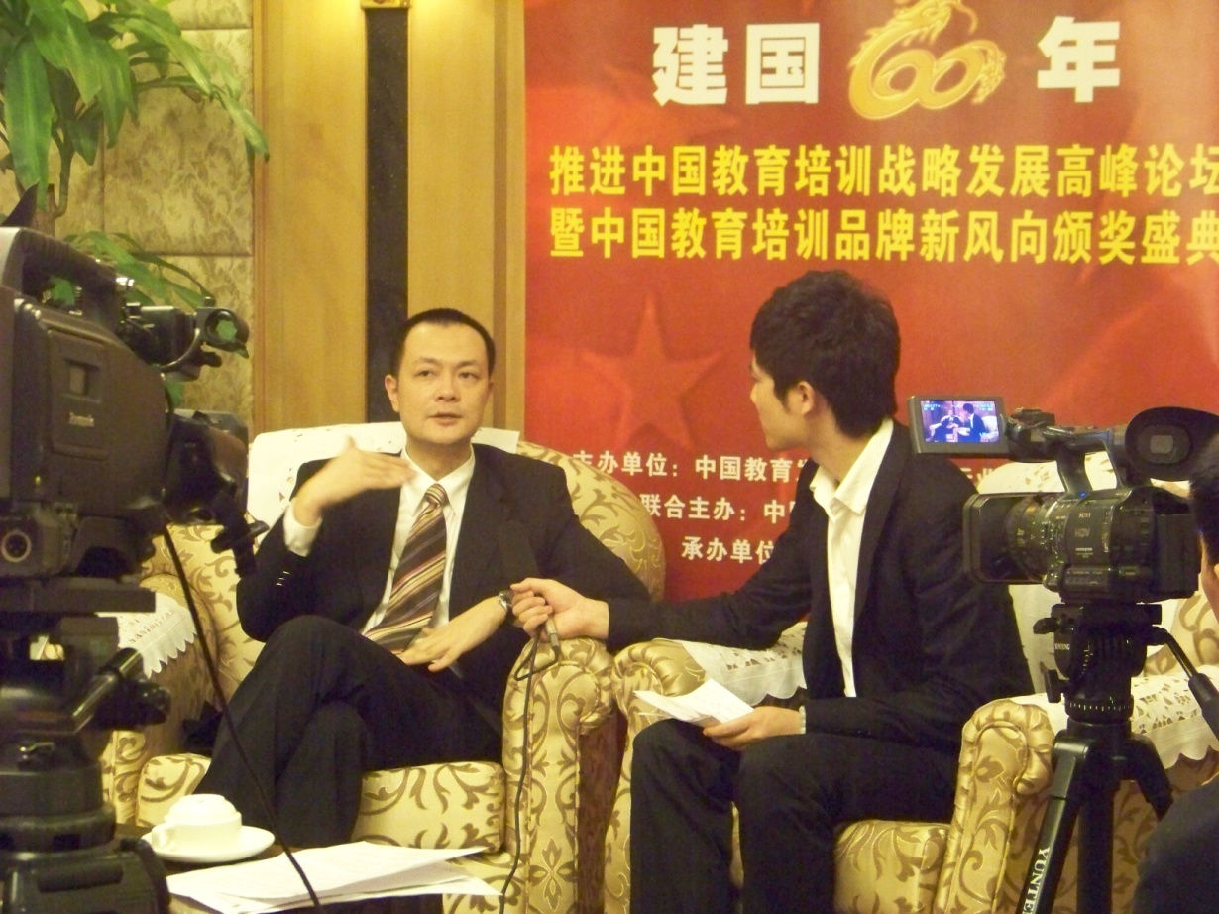
主讲嘉宾：刘洪波
贵学教育总裁 北京雅思学校总校校长
建国60年推动中国教育培训功勋人物
网易2009中国教育年度大选——教育产业十大领军人物

Slide 3
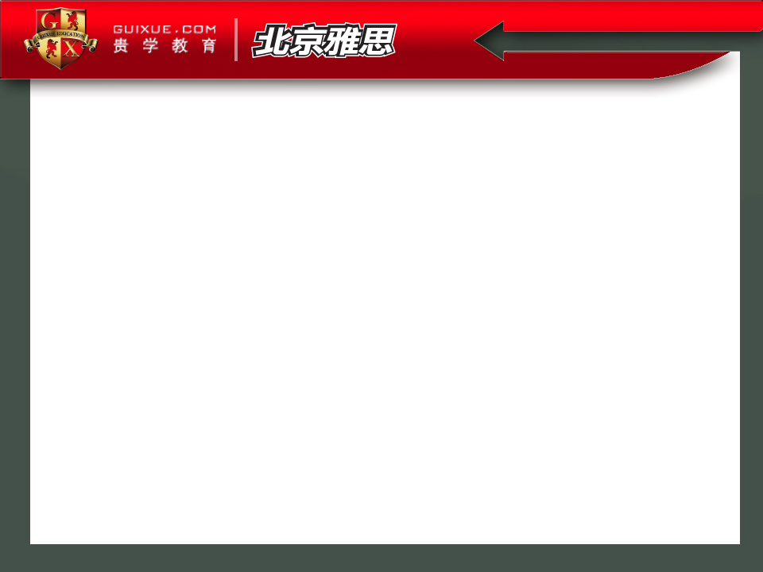
阅读要7+
如何读得快
如何读的懂
TFNG和Heading秘诀
近期热点总结
最近考什么

Slide 4
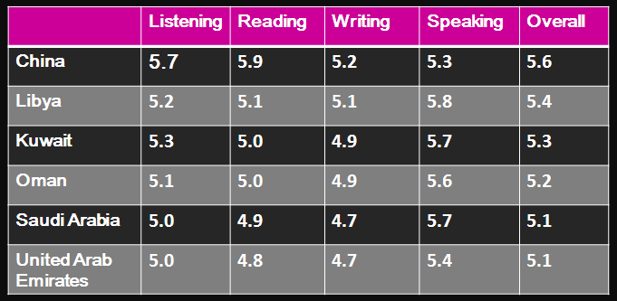
I. Mean band score for the most frequent countries or regions of origin

Slide 5
II. How to read faster
1. 物理疗法 NO SOUND
What a nice car!

Slide 6
II. How to read faster
2. 正确浏览 Skim

Slide 7
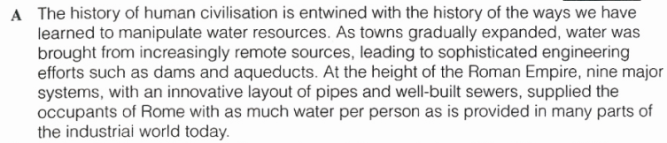
II. How to read faster
3. 最快速雅思阅读法
剑7.1.2

Slide 8
II. How to read faster
剑7.1.2
1. Paragraph A
xi A description of ancient water supplies
8. TFNG
Water use person is higher in the industrial world
than it was in Ancient Rome.

Slide 9
III. How to understand more
“天下间的所有阅读考题只有一种命题方式，无论雅思托福、四六级考研、GRE、GMAT。”

Slide 10
III. How to understand more
《剑桥雅思7》第25页第21题。
文章标题：Make every drop count
题型：TRUE/FALSE/NOT GIVEN
题目：Feeding increasing populations is possible due primarily to improved irrigation system.
原文：Food production has kept pace with soaring populations mainly because of the expansion of artificial irrigation systems that make possible the growth of 40% of the world’s food.

Slide 11
III. How to understand more
《剑桥雅思7》第21页第13题。文章标题：Let’s Go Bats
题型：Sentence Completion（句子填空）
题目：The word 'echolocation' was first used by someone working as a ………… (NO MORE THAN TWO WORDS)
原文：
…The American zoologist Donald Griffin, who was largely responsible for the discovery of sonar in bats, coined the term 'echolocation' to cover both sonar and radar, whether used by animals or by human instruments.

Slide 12
III. How to understand more
《剑桥雅思7》第91页第13题。
文章标题：Pulling strings to build pyramids
题型：Summary（总结填空）
题目：In addition, over two thousand years ago kites were used in China as weapons, as well as for sending ………… (NO MORE THAN TWO WORDS)
原文：
…And other ancient civilisations certainly knew about kites; as early as 1250 BC, the Chinese were using them to deliver messages and dump flaming debris on their foes.

Slide 13
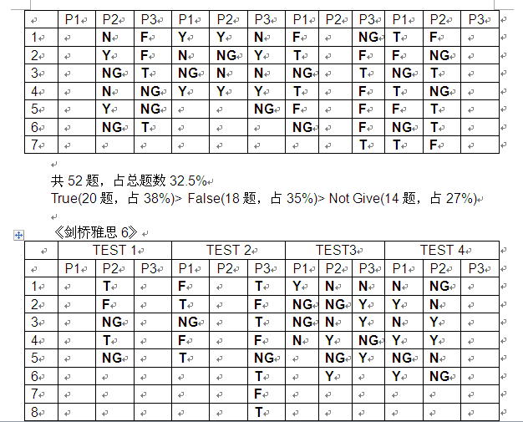
IV. Secrets to TFNG

Slide 14
IV. Secrets to TFNG
T
F
NG
T
T
NG

Slide 15
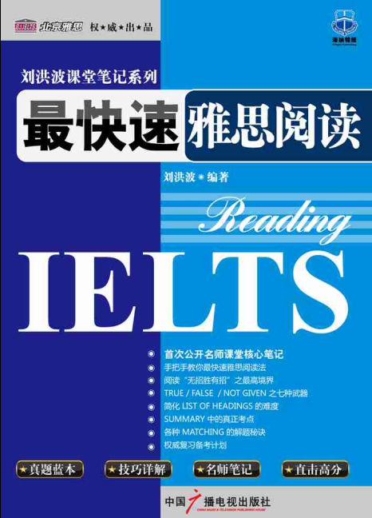
IV. Secrets to TFNG
命题之七种武器

Slide 16
IV. Secrets to Headings
C Yet there is a dark side to this picture: despite our progress, half of the world's population still suffers, with water services inferior to those available to the ancient Greeks and Romans. As the United Nations report on access to water reiterated in November 2001, more than one billion people lack access to clean drinking water; some two and a half billion do not have adequate sanitation services. Preventable water-related diseases kill an estimated 10,000 to 20,000 children every day, and the latest evidence suggests that we are falling behind in efforts to solve these problems.

Slide 17
IV. Secrets to Headings
D The consequences of our water policies extend beyond jeopardising human health. Tens of millions of people have been forced to …
vii. The relevance to health

Slide 18
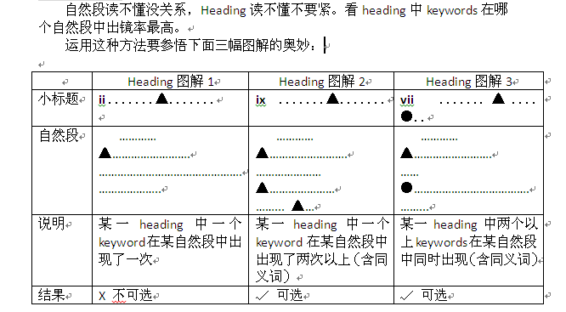
IV. Secrets to Headings

Slide 19
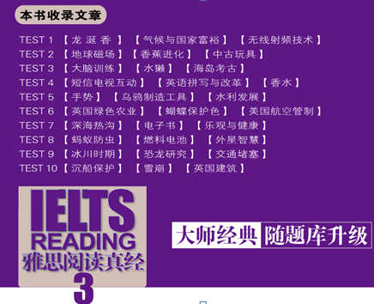
V. Hot Topics
12/01/12
雪崩
Avalanche
12/09/06
吉尔伯特
和磁场
Magnetism

Slide 20
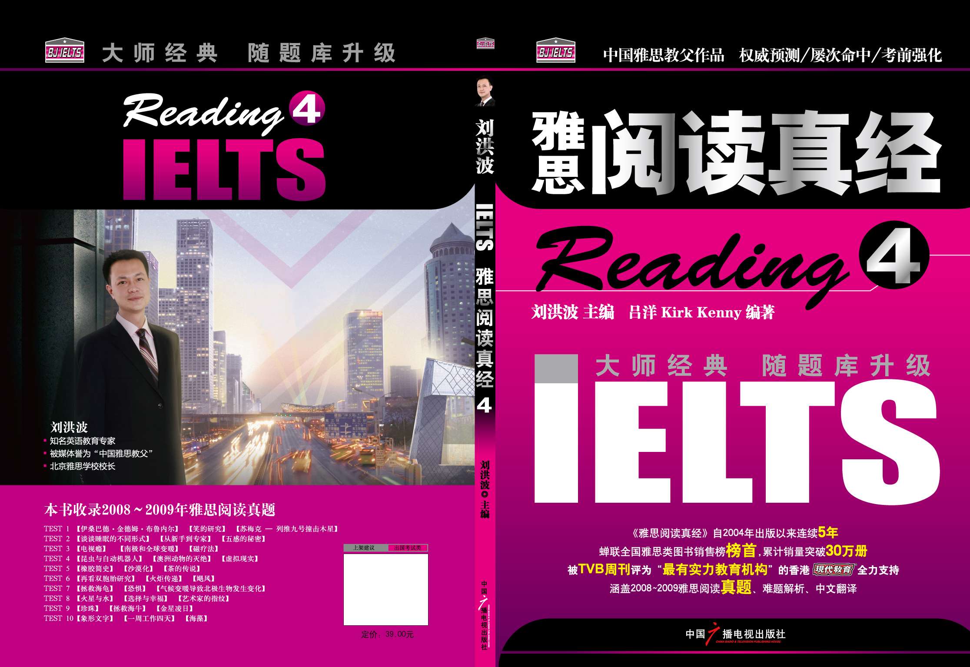
V. Hot Topics
12/02/04
奥运火炬
Olympic
Torch
12/03/08
飓风
Hurricane
12/03/31
磁疗
Magnetic
Therapy

Slide 21
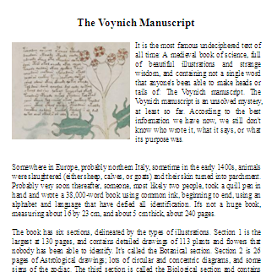
V. Hot Topics
12/05/19
Voynich manuscript
文章导读
神秘的伏尼契手稿静静躺在耶鲁大学的图书馆里；精美的插图，流畅的文字，却无人认识；是古代炼金术士的记录？是占星家的谜语？还是外星人遗失的画册？随着专家的分析，答案正在揭晓…..
parchment
undeciphered
properties
maneuver

Slide 22
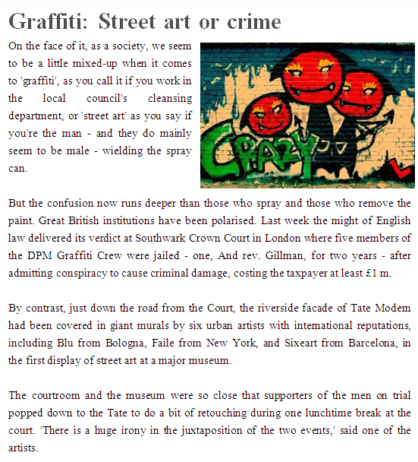
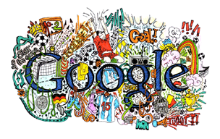
V. Hot Topics
12/08/25
Graffiti
Doodle

Slide 23
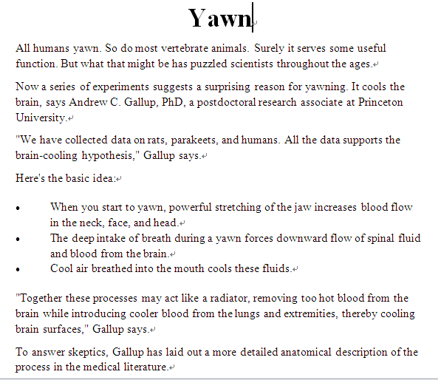
V. Hot Topics
12/09/22
Yawn
文章导读
我们为什么打哈欠？是因为犯困还是感到无聊？为什么打哈欠会传染？打哈欠在生理上对人体有什么作用？
contagious effect
infect

Slide 24
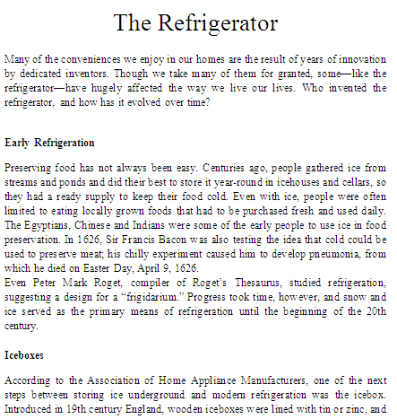
V. Hot Topics
12/09/22
The Refrigerator
文章导读
古人制冷的方法；冰箱的发明和改良；冰箱和制冷技术促进了许多行业的发展，改变了人们的饮食习惯和生活方式，促进了健康；家里可以没有电视但不能没有冰箱；冰箱还可应对雅思口语和写作话题——“谈谈生活中的一种电器产品”，“上世纪伟大的发明之一”；考鸭爱冰箱。

Slide 25



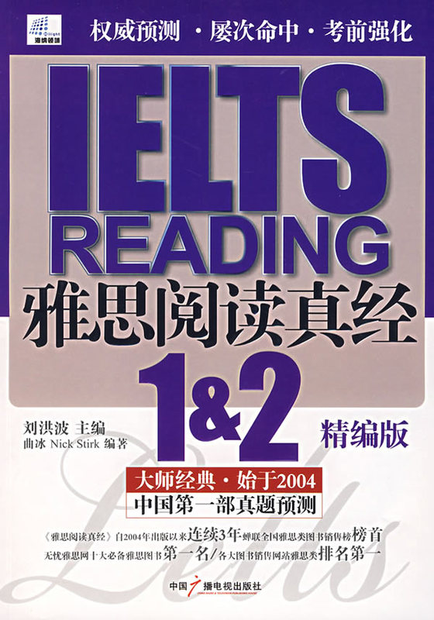
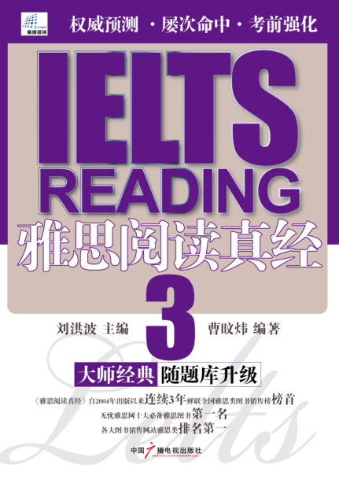
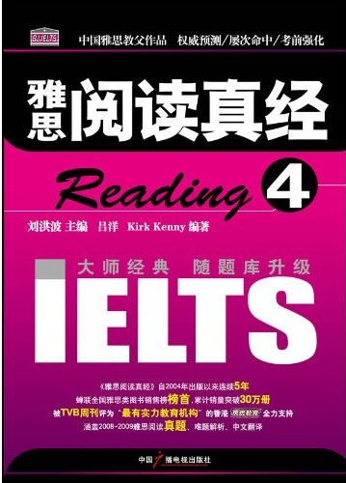

Slide 26

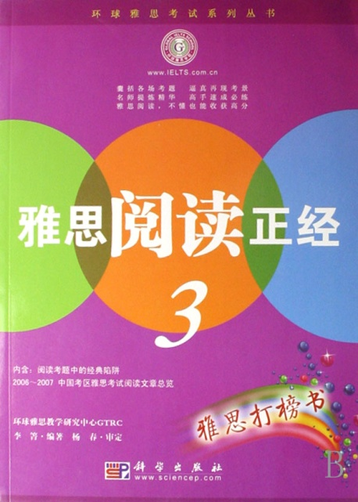

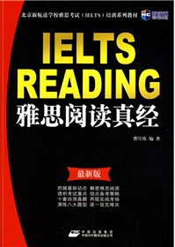
各种跟风

Slide 27
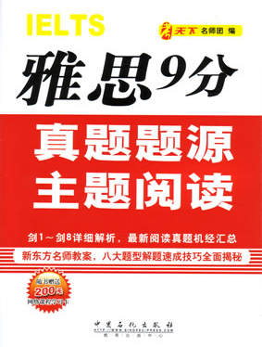
直接抄袭

Slide 28
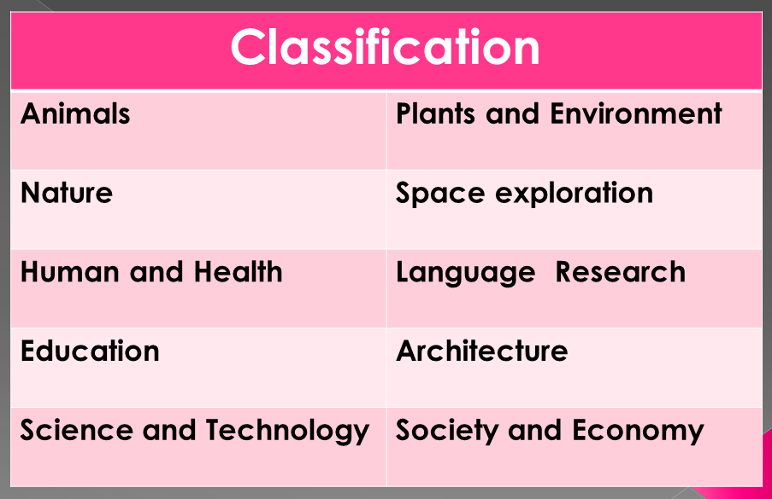
VI. Coming Next

Slide 29
P.S. Tips for IETLS Candidates
Listening
Reading
Writing
Speaking

Slide 30



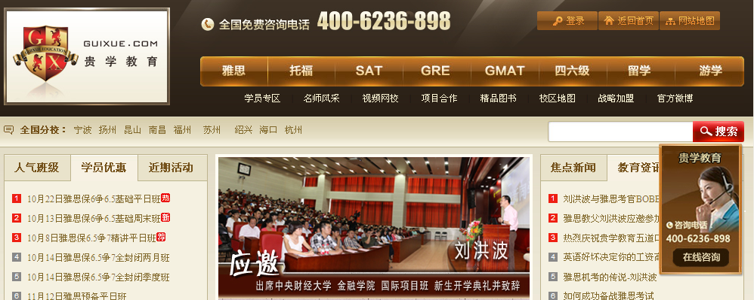
Where to find me?

Slide 31


