Slide 1
雅思写作——小作文

Slide 2
大纲要求
作文一
题型要求：作文一中会给出一些视觉性的信息，如一个或多个互相关联的图表、图解或表格，考生需对这些信息或数据进行描述。需要运用学术写作的文体。
评分标准：作文一考察的是考生在图表或表格中选择最重要和最相关的信息（一些次要的信息则可忽略）、并对这些信息进行清晰描述的能力，考官将对考生组织这些信息的能力以及语言使用的准确性进行评分。字数至少达到150字，否则将会被扣分。
考官将从以下方面对作文进行评分：
1、是否完成写作要求，能否有效地找到信息中关键的内容并对之进行描述和写作；
2、连贯性和结构层次，能否将信息和要点进行组织，信息和要点之间的联系是否清晰；
3、词汇来源是否广泛、准确且适合这一部分写作的要求；
4、语法结构是否多样、准确且适合这一部分写作的要求。

Slide 3
大纲要求

Slide 4
大纲要求

Slide 5
小作文（Task I）类型
1. 图表
2. 地图
3. 流程图

Slide 6
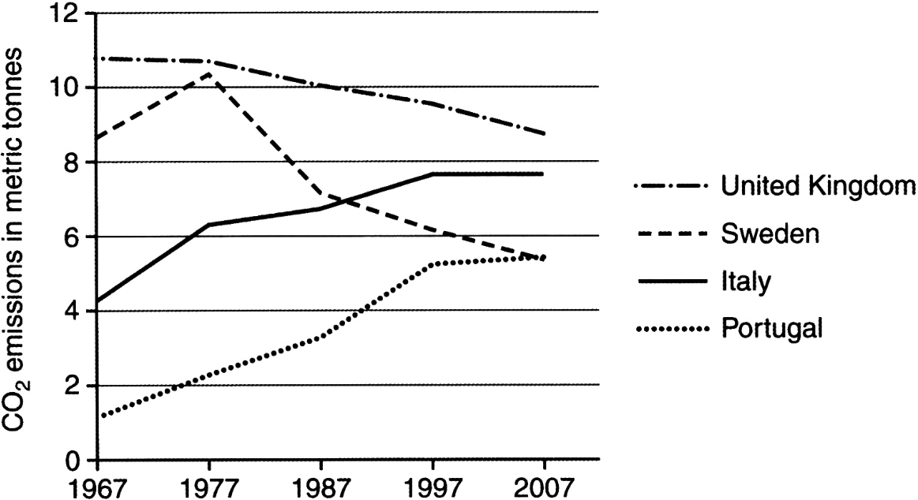
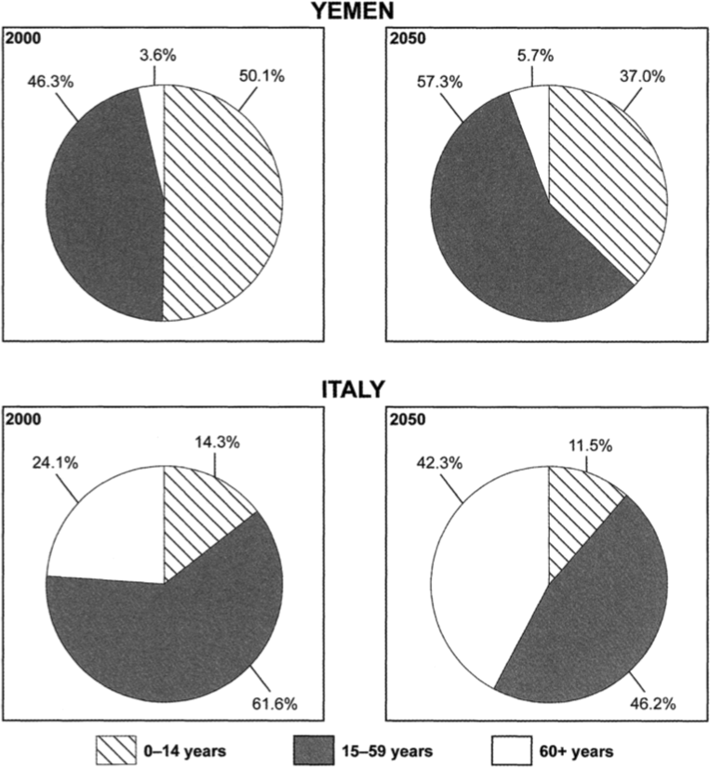
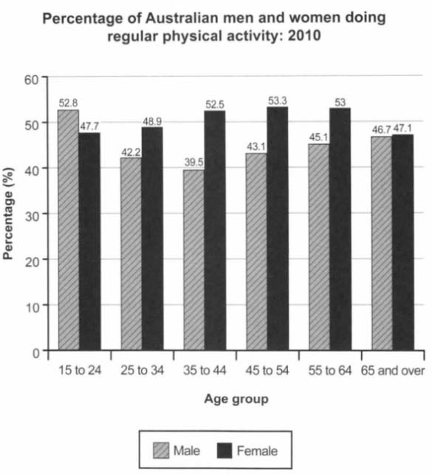
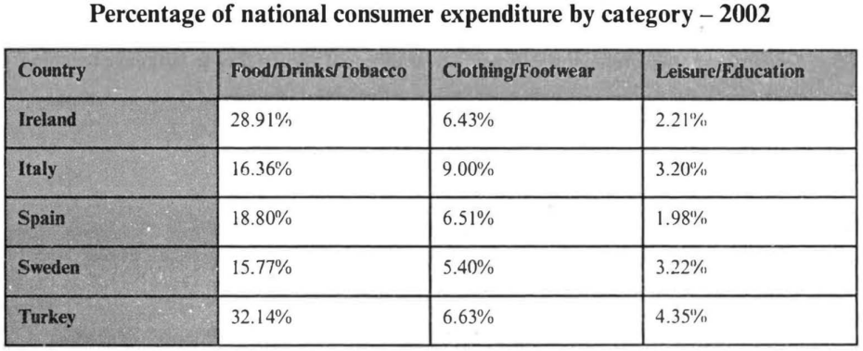
小作文（Task I）——图表

Slide 7
小作文（Task I）——地图

Slide 8
小作文（Task I）——流程图

Slide 9
小作文（Task I）难点及优势
难点：
1、图表信息繁多
2、具有一定专业性
3、需要合理分析
优势：
1、英语关键信息

Slide 10
小作文——图表

Slide 11
小作文（Task I）——图表构思
三段论：
1、开头段
对图表内容进行简单概括
2、主体段
对图表细节进行详细说明
3、结尾段
对图表进行简单总结或评论

Slide 12
小作文（Task I）——图表构思
开头段：概括图表主题
体现表头内容。
主体段：描述图表细节
概括总体特点
动态图：先指出总体趋势（上升、下降、平稳），再挑出极值（最高、最低）描写，如果可能，还应指出转折点。
静态图：先指出包含项目，再挑出极值（最高、最低）描写，如项目不多，也可按降序逐一描写。
比较异同
结尾段：总结评论图表
总结

Slide 13
小作文（Task I）——图表写作
写作句型：
1. 开头段
The bar chart/ line chart/ pie chart/ table explicitly displays/ demonstrates/ covers the change/ fluctuation/ proportion/ ratio/ statistics of...（主题）of ... and...（对象）in/ during...（持续时间） from... to...（始终时间）
The bar chart/ line chart/ pie chart/ table explicitly displays/ demonstrates the striking contrast of... （主题）between... and... （比较对象） from... to... （始终时间）
Reflected in the bar chart/ line chart/ pie chart/ table is the change/ fluctuation/ proportion of... （主题） from... to... （始终时间） / between... and... （比较对象）

Slide 14
小作文（Task I）——图表写作
主体段：
先指出总体趋势（上升、下降、平稳），再挑出极值（最高、最低）描写。
趋势：
It is clearly indicated that...（主题+对象）ascended/ descended steeply/ mildly/ steadily from…（起始值）to…（最终值）during this period of time.
The past... （时间段）years/ months witnessed the rapid/ mild/ steady increase/ decrease of... （主题+对象） from... （起始值）to...（最终值）during this period of time.
It is clearly indicated that...（主题+对象）remained stable/ fluctuated drastically during this period of time.
The past... （时间段）years/ months witnessed the relative stability/ the drastic fluctuation of... （主题+对象） during this period of time.

Slide 15
小作文（Task I）——图表写作
如需表示两个或两个以上同时增加或减少：
It is clearly indicated that...（主题+对象）ascended/ descended steeply/ mildly/ steadily respectively from...（起始值）to...（最终值）and from...（起始值）to...（最终值） during this period of time.
The past... （时间段）years/ months witnessed the rapid/ mild/ steady increase/ decrease of... （主题+对象）respectively from... （起始值）to...（最终值） and from...（起始值）to...（最终值）.
如需表示具体增加或减少的比例：
It is clearly indicated that... （主题+对象） ascended/ descended steeply/ mildly/ steadily by...%（增加或减少的百分比） from...to... （起始值）to...（最终值） during this period of time.
It is clearly indicated that... （主题+对象） doubled/ tripled/ quadrupled from... （起始值）to...（最终值） during this period of time.

Slide 16
小作文（Task I）——图表写作
对比：
… （主题+对象） outran/ overtook/ surpassed/ exceeded… （另一主题+对象） in… （时间） by… （超过的幅度）.
It is clearly indicated that... （主题+对象） ascended/ descended steeply/ mildly/ fluctuated drastically from... （起始值）to...（最终值） / remained stable/ levelled off, while/ whereas ... （另一主题+对象） underwent/ experienced a rapid/ mild increase/ decrease/ relative stability/ drastic fluctuation from... （起始值）to...（最终值）.
It is clearly indicated that... （主题+对象） ascended/ descended steeply/ mildly/ fluctuated drastically from... （起始值）to...（最终值） / remained stable during this period of time, which, on the contrary, witnessed the rapid/ mild increase/ decrease/ relative stability/ drastic fluctuation of... （另一主题+对象） from... （起始值）to...（最终值）.

Slide 17
小作文（Task I）——图表写作
极值：
The number/ percentage of... （主题+对象） rocketed to the highest point/ peak of ...（最高值） in...（时间） and stumbled to the bottom of...（最低值） in...（时间）
转折点：
The significant turning point occurred in...（时间点）, when ... （主题+对象） began to rise/ fall/ level off, reversing its general trend in the past... years/ months （时间段）.
...（时间点） witnessed the significant turning point, at which ...（主题+对象） began to rise/ fall/ level off, reversing its general trend in the past... years/ months（时间段）.

Slide 18
小作文（Task I）——图表写作
百分比、排序：
先指出包含项目，再挑出极值（最高、最低）描写，如项目不多（五个以内），也可按降序逐一描写（如项目太多，“其他”项可以忽略）。
Among all the...（项目数量） items included in the survey, ...（最多项） outran the others/ took the lead, with ...%（百分比）, while …（最少项） ranked the last/ lay at the bottom, making up only ...% （百分比）.
Among all the...（项目数量） items included in the survey, ...（最多项） outran the others, with ...%（百分比）. （次多项） came as the runner-up, which occupied ...% （百分比）, followed by （第三多项） and （第四多项）, which accounted for ...% （百分比） and ...% （百分比） respectively. …（最少项） ranked the last, making up only ...% （百分比）.
As is clearly indicated in the graph, ...（最多项）made up…（百分比）, topping the survey. What came next was ... （次项）, which accounted for ...%（百分比）. Minor ...（小项） included ...(...%), ...(...%) and other ... (...%)（小项罗列+百分比）.

Slide 19
小作文（Task I）——图表写作
主体段衔接手段：
First, above all, first of all
Then, furthermore, in addition, what’s more
Finally, at last
What arrests my attention most is…
What is worth mentioning is…
The most interesting part is…
One thing that can’t be ignored is…

Slide 20
小作文（Task I）——流程图写作
结尾段：
We can draw a safe conclusion that...
To sum up, the major difference lies in…While…, …

Slide 21
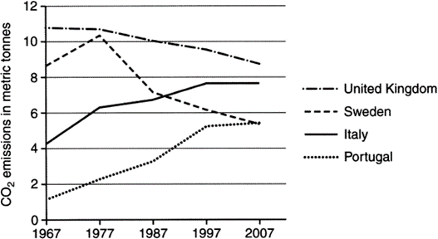
小作文（Task I）——图表练习
The graph below shows average carbon dioxide (CO₂) emissions per person in the United Kingdom, Sweden, Italy and Portugal between 1967 and 2007.
Summarize the information by selecting and reporting the main features, and make comparisons where relevant.

Slide 22
小作文（Task I）——图表练习
开头段：
Reflected in the line chart is the change of … from …to …
Reflected in the line chart is the change of average carbon dioxide (CO₂) emissions per person in four European countries, namely, the United Kingdom, Sweden, Italy and Portugal from 1967 to 2007.

Slide 23
小作文（Task I）——图表练习
主体段：
It is clearly indicated that …, while ....
It is clearly indicated that the carbon emissions in Italy and Portugal ascended drastically from 4.2 metric tonnes to 7.8 and from 1.4 to 5.6 respectively, while those in UK and Sweden underwent a steady decrease from 10.6 metric tonnes to 8.4 and from 8.4 to 5.6 respectively.
What is worth mentioning is ...
What is worth mentioning is Sweden, whose production of CO₂ rocketed to the peak of 10.2 metric tonnes in 1977 and stumbled to the bottom of 5.6 in 2007.
The significant turning point occurred in …, when …
The significant turning point occurred in 1977, when that number began to fall, reversing its general trend in the past decade.

Slide 24
小作文（Task I）——图表练习
结尾段：
We can draw a safe conclusion that...
We can draw a safe conclusion that although all the four countries are developed ones in Europe, they differ greatly in average carbon dioxide (CO₂) emissions per person.

Slide 25
小作文（Task I）——图表练习
Reflected in the bar chart is the change of average carbon dioxide (CO₂) emissions per person in four European countries, namely, the United Kingdom, Sweden, Italy and Portugal from 1967 to 2007.
It is clearly indicated that the carbon emissions in Italy and Portugal ascended drastically from 4.2 metric tonnes to 7.8 and from 1.4 to 5.6 respectively, while those in UK and Sweden underwent a steady decrease from 10.6 metric tonnes to 8.4 and from 8.4 to 5.6 respectively. What is worth mentioning is Sweden, whose production of CO₂ rocketed to the peak of 10.2 metric tonnes in 1977 and stumbled to the bottom of 5.6 in 2007. The significant turning point occurred in 1977, when that number began to fall, reversing its general trend in the past decade.
We can draw a safe conclusion that although all the four countries are developed ones in Europe, they differ greatly in average carbon dioxide emissions per person. (157 words)

Slide 26
小作文（Task I）——图表练习
The bar chart below shows the percentage of Australian men and women in different age groups who did regular physical activity in 2010.
Summarize the information by selecting and reporting the main features, and make comparisons where relevant.

Slide 27
小作文（Task I）——图表练习
开头段：
The following bar graph illustrates the proportion of … in....
The following bar graph illustrates the proportions of Australian population in both genders who did exercises regularly in 2010.

Slide 28
小作文（Task I）——图表练习
主体段：
Overall, … outran … in ....
Overall, females outran males in almost all age groups except for that of 15 to 24.
For …, the figure rocketed to the peak of … and stumbled to the bottom of …, while for …, the highest point appeared … with … and the least… with …
For women, the figure rocketed to the peak of 53.3% between 45 and 54 and stumbled to the bottom of 47.1 between 65 and over, while for men, the highest point appeared between 15 and 24 with 52.8% and the lowest between 35 and 44 with only 39.5%.

Slide 29
小作文（Task I）——图表练习
Furthermore, … overtook … most by … and least by ...
Furthermore, females overtook males most by 13% between 35 and 44 and least by 0.4% between 65 and over.
One thing that can’t be ignored is ...
One thing that can’t be ignored is the beginning age group of 15 to 24, in which boys surpassed girls, the only exceptional case among all the age groups listed in the chart.

Slide 30
小作文（Task I）——图表练习
We can draw a safe conclusion that…
We can draw a safe conclusion that men’s physical activities started high in their juvenile period, dropped in their youth and middle age, and finally rose slightly in their senile time, while women experienced a reverse trend.

Slide 31
小作文（Task I）——图表练习
The following bar graph illustrates the proportions of Australian population in both genders who did exercises regularly in 2010.
Overall, females outran males in almost all age groups except for that of 15 to 24. For women, the figure rocketed to the peak of 53.3% between 45 and 54 and stumbled to the bottom of 47.1 between 65 and over, while for men, the highest point appeared between 15 and 24 with 52.8% and the lowest between 35 and 44 with only 39.5%. Furthermore, females overtook males most by 13% between 35 and 44 and least by 0.4% between 65 and over. One thing that can’t be ignored is the beginning age group of 15 to 24, in which boys surpassed girls, the only exceptional case among all the age groups listed in the chart.
We can draw a safe conclusion that men’s physical activities started high in their juvenile period, dropped in their youth and middle age, and finally rose slightly in their senile time, while women experienced a reverse trend.
(171 words)

Slide 32
小作文（Task I）——图表练习
The charts below give information on the ages of the populations of Yemen and Italy in 2000 and projections for 2050.
Summarise the information by selecting and reporting the main features, and make comparisons where relevant.

Slide 33
小作文（Task I）——图表练习
The pie charts explicitly cover the proportions of the populations of different age groups in Yemen and Italy in 2000 and their projections for 2050.
Among all the 3 items included in the survey for Yemen in 2000, the number of people between 0 and 14 outran the others, with 50.1%. Those between 15 and 59 came as the runner-up, which occupied 46.3%. The citizens over 60 ranked the last, making up only 3.6%. However, it is predicted that in 2050, the population between 15 and 59 (57.3%) will surpass that between 0 and 14 (37.0%) to become the largest age group.
In contrast, for Italy in 2000, the population of 15-59 age group made up 61.6%, topping the survey. What came next was those over 60, which accounted for 24.1%, followed by the people between 0-14, with 14.3% only. The general situation expected in 2050 is similar, with 46.2%, 42.3% and 11.5% respectively.
I can draw a safe conclusion that Italy and Yeman share the same trend in the population change of teenagers and elderly people but show a reverse one in young- and middle-aged men. (188 words)

Slide 34
小作文（Task I）——图表练习
The table below gives information on consumer spending on different items in five different countries in 2002.
Summarise the information by selecting and reporting the main features, and make comparisons where relevant.

Slide 35
小作文（Task I）——地图构思
三段论：
1、开头段
对地图内容进行简单概括
2、主体段
对地图细节进行详细说明
3、结尾段
对地图进行简单总结

Slide 36
小作文（Task I）——地图构思
开头段：概括地图主题
体现标题内容。
主体段：描述图表细节
概括总体特点
描述异同
结尾段：总结评论图表
总结

Slide 37
小作文（Task I）——地图构思
地图描述原则：
整体到局部
中心到周围
北到南，西到东
顺时针或逆时针
沿地标物

Slide 38
小作文（Task I）——地图写作
写作句型：
1. 开头段
The maps explicitly display/ demonstrate/ cover the change/ comparison of...（主题）
The maps explicitly display/ demonstrate the striking contrast of the present/ existing... （主题）and the future/ predicted... （主题）
Reflected in the maps is the change/ comparison of... （主题）

Slide 39
小作文（Task I）——地图写作
2. 主体段
概括总体特点
In general/ Overall, there is/ will be a significant change/ difference in terms of…
In general/ Overall, … remains almost the same with some minor/ fine changes/ differences.

Slide 40
小作文（Task I）——地图写作
2. 主体段
描述细节
… is composed of… parts, namely…
In the centre of… lies …, surrounded by… on the west, … on the north, … on the east and … on the south.
There is a… to the west/ east, which…
Located to the north/ south is…, which…
… is located/ situated/ found in/ on/ to the north/ east/ south/ west of…
… is located/ situated/ found … kilometres north/ east/ south/ west of…
…(railway, road, river) runs through… in north/ east/ south/ west from… to…
… is far from/ near to…

Slide 41
小作文（Task I）——地图写作
2. 主体段
比较异同
…, while/ whereas…
… will be replaced by/ give way to…
… will be extended/ expanded/ enlarged by… to include…
… will be relocated to…
At present, …/ In the future, …/ In contrast, …

Slide 42
小作文（Task I）——地图写作
主体段衔接手段：
First, above all, first of all
Then, furthermore, in addition, what’s more
Finally, at last
What arrests my attention most is…
What is worth mentioning is…
The most interesting part is…
One thing that can’t be ignored is…

Slide 43
小作文（Task I）——流程图写作
结尾段：
（结论）
We can draw a safe conclusion that...
To sum up, the major difference lies in…While…, …

Slide 44
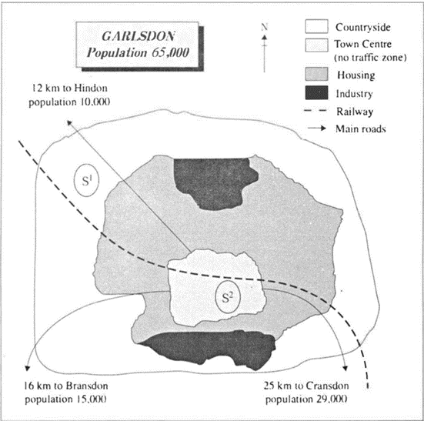
小作文（Task I）——地图练习
The map below is of the town of Garlsdon. A new supermarket is planned for the town.
The map shows two possible sites for the supermarket.
Summarize the information by selecting and reporting the main features, and make comparisons where relevant.

Slide 45
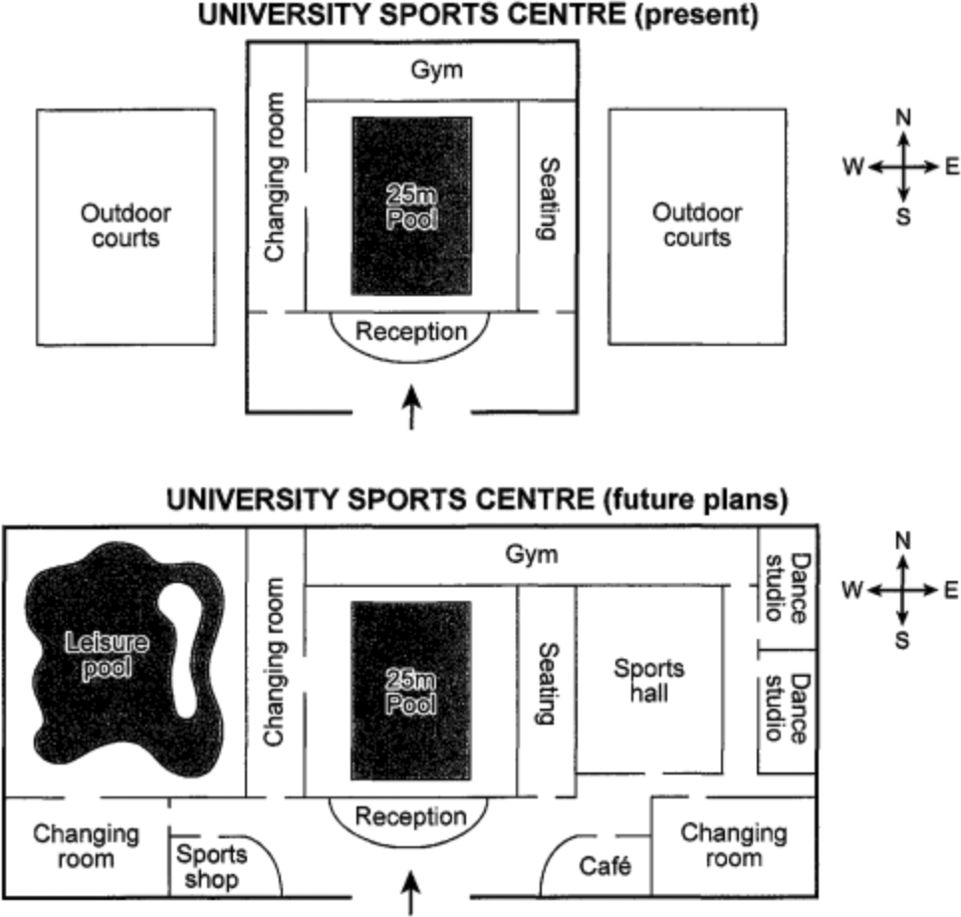
小作文（Task I）——地图练习
The plans below show the layout of a university sports centre now, and how it will look after redevelopment.
Summarize the information by selecting and reporting the main features, and make comparisons where relevant.

Slide 46
小作文（Task I）——地图练习
The maps explicitly demonstrate the striking contrast of the existing layout of a university sports centre and its future plan.
In general, there will be a significant change in terms of the overall layout.
At present, the sports centre is composed of only a 25m pool in the centre surrounded by a changing room on the west, a gym on the north, some seating on the east, and a reception on the south, and outdoor courts to both ends in the west and east.
After redevelopment, the outdoor courts in the west will be replaced by a leisure pool, and meanwhile extended to the south to include a changing room and a sports shop at the entrance, while those in the east will give way to a sports hall and be expanded to the east for two independent dance studios and to the south for a café at the entrance and a changing room.
We can draw a safe conclusion that the sports centre is not only enlarged but also equipped with more functional areas which will meet more diversified needs.
(181 words)

