Slide 1
写作强化（1） - 小作文 Task 1
(考场争取在5min之内完成图表写作的准备工作)
基本任务 – 图表展示了什么
整体趋势 – 总的来说数据的特征是怎样 (地图的变化是怎样/流程的步骤有几个阶段)
写作框架 – 文章分段、先写什么再写什么
关键数据 – 根据分段和写作顺序，每一组数据的要写哪些关键点 (每个地图上的重要特征、变化；每个流程中的动作；)
全篇布局确认
写作

Slide 2
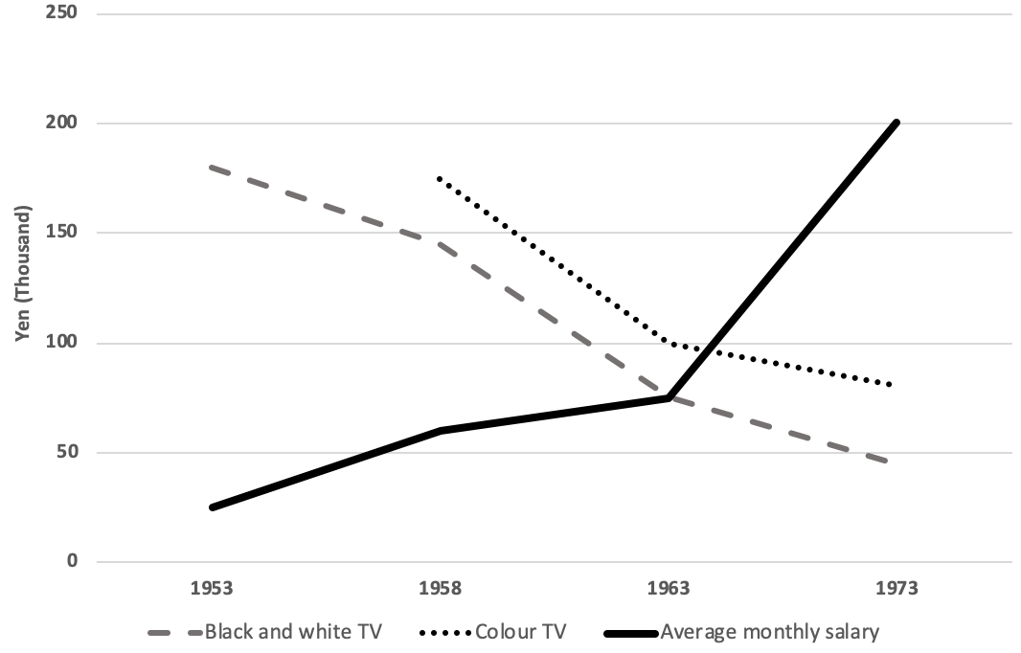
Line graph-2020.8.8真题
The graph below shows the changes of Japanese average monthly salary from 1953 to 1973, together with prices of black and white TV and colour TV in Japanese Yen during this period.
Summarise the information by selecting and reporting the main features, and make comparisons where relevant.

Slide 3
Line graph-2020.8.8真题
Notes
本图除按顺序描述变化以外，需要注意的要点：
Color TV had not been in market until 1958.
TV became more affordable for Japanese.
The graph below shows the changes of Japanese average monthly salary from 1953 to 1973, together with prices of black and white TV and colour TV in Japanese Yen during this period.
Summarise the information by selecting and reporting the main features, and make comparisons where relevant.

Slide 4
Bar chart – C12-Test 7
The chart below shows how frequently people in the USA ate in fast food restaurants between 2003 and 2013.
Summarise the information by selecting and reporting the main features, and make comparisons where relevant.

Slide 5
Bar chart – C12-Test 7
The chart below shows how frequently people in the USA ate in fast food restaurants between 2003 and 2013.
Summarise the information by selecting and reporting the main features, and make comparisons where relevant.
Notes：
此类图表可以选择按时间分段、按变量分段；
通常按变量分段更合理（X轴）；
变量可以进行重新排序和分组，使信息更符合逻辑

Slide 6
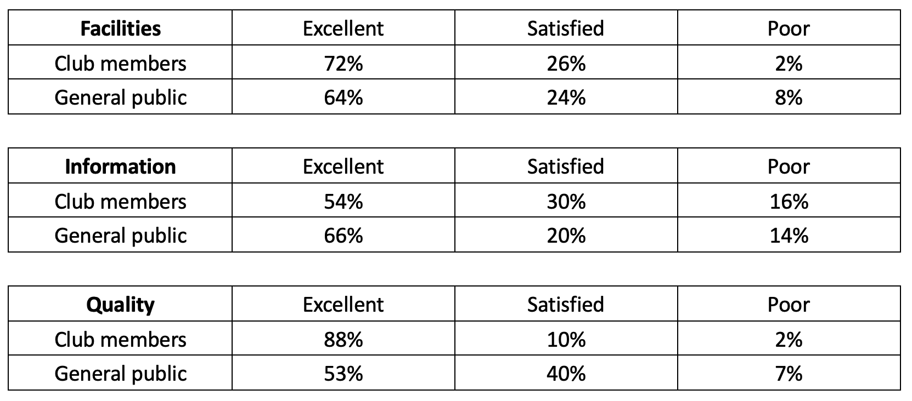
Table-2020.7.25真题
The tables below show the questionnaire about opinions of club members and general public for the new theatre in one town in 2012.
Summarise the information by selecting and reporting the main features, and make comparisons where relevant.

Slide 7
Table-2020.7.25真题
Notes：
此类图表需注意信息整理清晰；
通常一个表格一段更合理；
3个表格按照一定的逻辑分组或排序，突出重点；
The tables below show the questionnaire about opinions of club members and general public for the new theatre in one town in 2012.
Summarise the information by selecting and reporting the main features, and make comparisons where relevant.

Slide 8
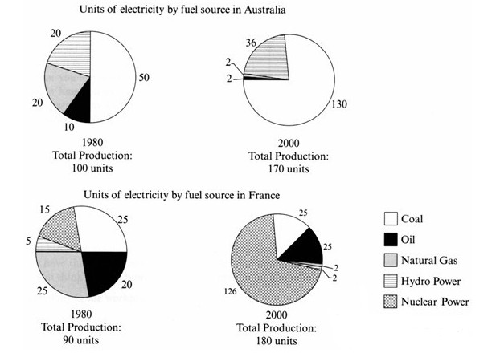
Pie chart-C7-T4-Task 1
The pie charts below show units of electricity production by fuel source Australia and France in 1980 and 2000.
Summarise the information by selecting and reporting the main features, and make comparisons where relevant.

Slide 9
Pie chart-C7-T4-Task 1
Notes:
饼状图偶尔不是以百分比来显示的，需要留意；
饼状图个数大于2个时，需要灵活调整分段的方法；
本图建议按国家分段；
The pie charts below show units of electricity production by fuel source Australia and France in 1980 and 2000.
Summarise the information by selecting and reporting the main features, and make comparisons where relevant.

Slide 10
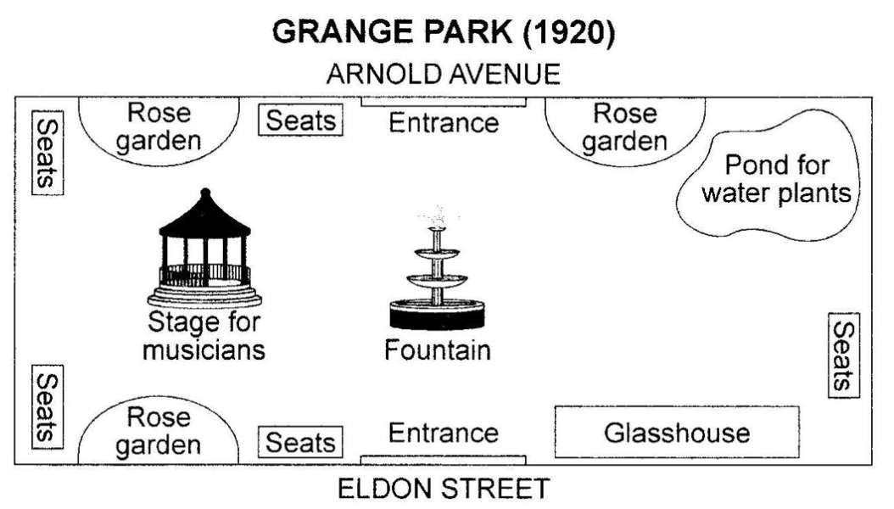
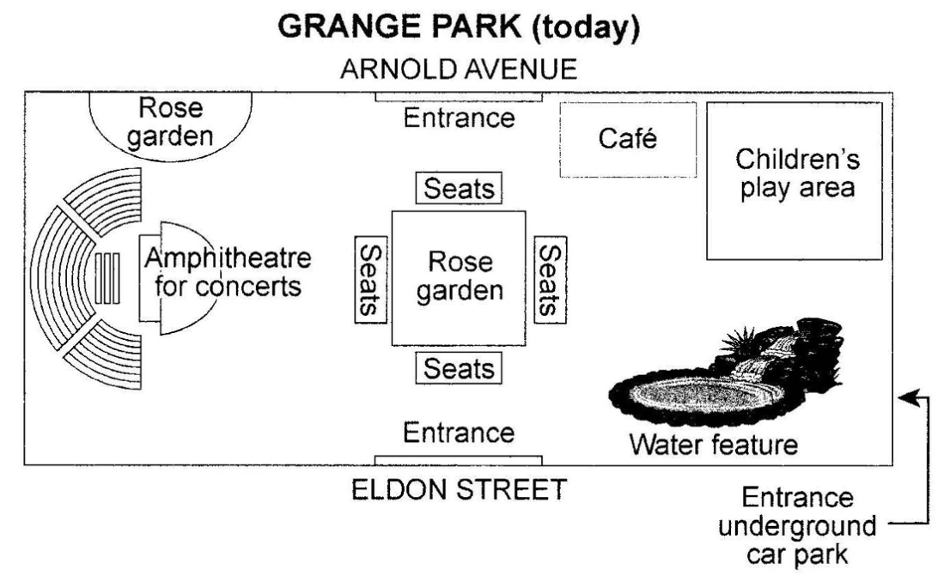
Map-C14-T4-Task 1
The plans below show a public park when it first opened in 1920 and the same park today.
Summarise the information by selecting and reporting the main features, and make comparisons where relevant.

Slide 11
Map-C14-T4-Task 1
The plans below show a public park when it first opened in 1920 and the same park today.
Summarise the information by selecting and reporting the main features, and make comparisons where relevant.
Notes:
场馆地图通常选择出入口作为参照物；
地图上的一些变化多观察，如seats/garden属于被relocate；

Slide 12
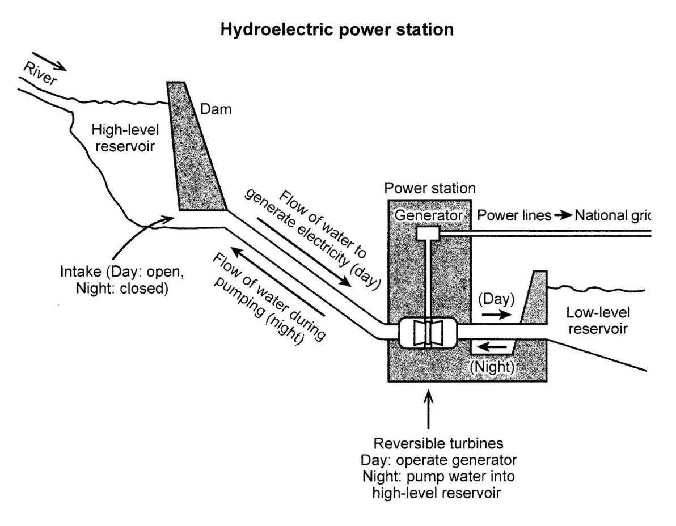
Sequence diagram-C14-T3-Task 1
The diagram below shows how electricity is generated in a hydroelectric power station.
Summarise the information by selecting and reporting the main features, and make comparisons where relevant.

Slide 13
Sequence diagram-C14-T3-Task 1
The diagram below shows how electricity is generated in a hydroelectric power station.
Summarise the information by selecting and reporting the main features, and make comparisons where relevant.
Notes: 流程图在分析图形时，尽量能将每一步的动作都看清楚再开始写作；
本图需要分为day/night两段来描述水力发电站的运作方式；

Slide 14
混合图形
Mixed charts – 2020.8.29真题
The char and table show information about water use and price in five countries.
Summarise the information by selecting and reporting the main features, and make comparisons where relevant.
Countries | US$ per cubic metre
The United States | 0.32
Canada | 0.60
Italy | 0.70
Germany | 2.70
France | 2.50

Slide 15
混合图形
Mixed charts – 2020.8.29真题
The char and table show information about water use and price in five countries.
Summarise the information by selecting and reporting the main features, and make comparisons where relevant.
Countries | US$ per cubic metre
The United States | 0.32
Canada | 0.60
Italy | 0.70
Germany | 2.70
France | 2.50
Notes:
混合图形的两个图分别都会简单一些；
通常两个图之间没有必要关联；
但如果发现有关联，则需要写出来；
本图中的关联是：
在水价相对更高的国家，人均每日用水则偏少，反之则偏多；
水价和用水量相乘可以得出人均每日用水的开销，可以作为总结来写；

