Slide 1
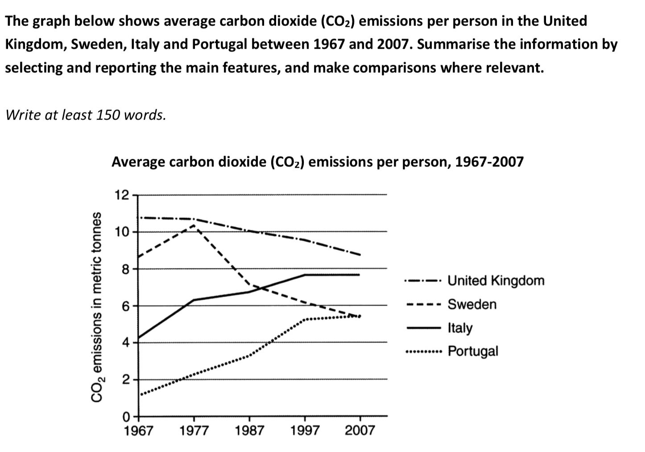
本课作业

Slide 2
C11T3T1
The line graph demonstrates how average CO2 emission per person changed from 1967 to 2007, by comparing the level in four European countries (the UK, Sweden, Italy and Portugal).
Obviously, the four countries showed different trends in that regard. The UK remained as the biggest producer of carbon dioxide throughout the period, although a gradual decline can be observed in the figure, which dropped from almost 11 metric tones to just above 8. The average emission level of Sweden also showed a decrease in general, from above 8 to less than 6 in 2007, despite there was a sharp increase in the first decade. By contrast, both Italy and Portugal experienced steep increases in carbon dioxide emission, with the former rising from below 4 to almost 8, and the latter reaching almost 5, which had matched that of Sweden by 2007. It is also worth noticing that the increase leveled off in the last decade.
Overall, in the given period of time, the UK and Sweden were more effective in controlling the emission of carbon dioxide, but the gap between these countries narrowed, with the amount approaching a similar level.
(186 words)

Slide 3
C11T3T1
关键词容易重复，如何同义替换？
average carbon dioxide emission per person

Slide 4
C11T3T1
关键词容易重复，如何同义替换？
average carbon dioxide emission per person
缩减关键词 the emission/ CO2 emission/ average emission in…
抽象名词代替 the level / emission level in … ; the figure for …
用代词替代上文提及
修改定语描述方式 the amount of CO2 emitted by people in …

Slide 5
C11T3T1
主语和动词的一致性
Starting as the lowest emission country, Portugal increased from … to …
这句有什么问题？

Slide 6
C11T3T1
主语和动词的一致性
Starting as the lowest emission country, Portugal increased from … to …
这句有什么问题？
Portugal 不能 ‘increase’
Starting as the country with the lowest emission, Portugal saw its level increasing from … to …
Starting as the lowest emission, the level in Portugal increased from … to…

Slide 7
C11T3T1
句型积累：
Both Italy and Portugal experienced steep increases in carbon dioxide emission, with the former rising from below 4 to almost 8, and the latter reaching almost 5, which had matched that of Sweden by 2007.
使用场景：2个对象变化（特征）相似，合并描写
学习要点：用the former和the latter指代上句中提到的两个对象
Both … and … experienced …,
with the former rising/declining from … to …, and the latter from … to …
(补充信息看情况)

