Slide 1
新GRE填空精讲精练
主讲教师：韩成宝

Slide 2
新GRE填空
主讲教师：韩成宝

Slide 3
韩成宝（宝爷）
——————
锡伯族（拓跋.鲜卑后裔）
新东方集团优秀教师
————————
中国大陆首位TEDx催眠讲师
美国NGH&HMI催眠动机学院注册催眠师
读心师
心理咨询师
IMS国际魔术师协会魔术师
————————————
口才演讲培训师
脱口秀演员
微信：xindongfangbaoye
公众号：催眠先生
微博：@考研大师宝爷

Slide 4
GRE扫盲
AWA + QV 10分钟 QVQ
AWA + VQ 10分钟 VQV
A ：30 + 30
V：30
Q：35
即时出分
130—170分
CAT

Slide 8
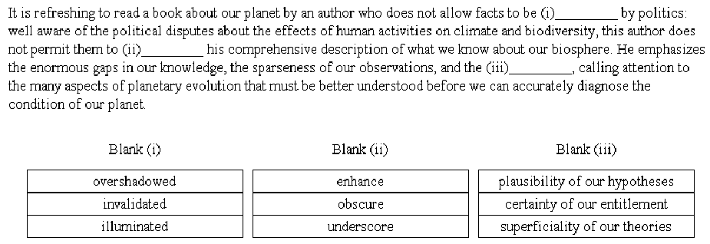

Slide 9
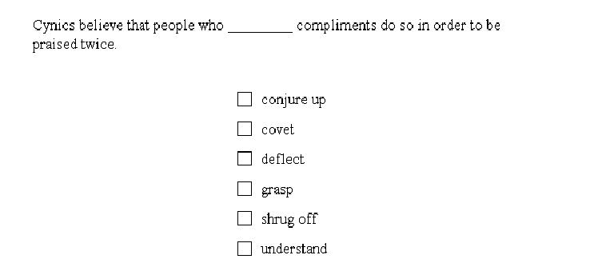

Slide 10
GRE填空：
一/二句话之内（除三空题），
通过句内已有的逻辑，找同反义词。

Slide 11
GRE填空考点：
1.单词:
2.逻辑：

Slide 12
汉语GRE填空：
他大舅，他二舅，都是_______。
A.他大爷
B.他大姨妈
C.他大姨夫
D.他大大
E.他妈的哥哥

Slide 13
溥仪，中国历史上最后一个封建社会皇帝，是一个________ 皇帝。
A.残暴的
B.好色的
C.勤政的
D.完蛋的
E.很怂的

Slide 14
溥仪，中国历史上最后一个封建社会皇帝，是一个______ 皇帝，他宵衣旰食，每天批阅大臣们上奏的文件达数百斤。
A.残暴的
B.好色的
C.勤政的
D.完蛋的
E.很怂的

Slide 15
游吟着“采菊东篱下，悠然见南山”的南北朝诗人陶渊明是一个______ 人.
A.官场失意的
B.斜眼儿的
C.出身很苦的
D.方向感很好的
E.铁骨铮铮的男

Slide 16
GRE考试到底需要多少词汇量？
有没有真相？

Slide 17
如何计算词汇量？
词目

Slide 18
do doing done
只是单词的变形，算1个词目

Slide 19
interest uninterested disinterested
含义不同，算3个词目

Slide 20
do doing done
只是单词的变形，算1个词目
interest uninterested disinterested
含义不同，算3个词目
根据词目的“纯统计”
－GRE考题约有9208个词目

Slide 21
In parts of the Arctic, the land grades into the landfast ice so ______ that you can walk off the coast and not know you are over the hidden sea.
(A) resurrectedly
(B) imperceptibly
(C) irregularly
(D) precariously
(E) relentlessly
（答案：B，出自GRE官网例题）

Slide 22
上题中词目共计29个
但显然词汇量29的人不可能会做这道题
为什么？

Slide 23
单词难度=生僻度
当代美语语料《Corpus of Contemporary American English》
根据其发布的单词词频数据，计算单词生僻度
数字越大越生僻
如下：

Slide 24
do＝32
abandon＝2203
relentlessly＝10098
我们统计GRE填空中的每个单词难度可以发现：

Slide 25
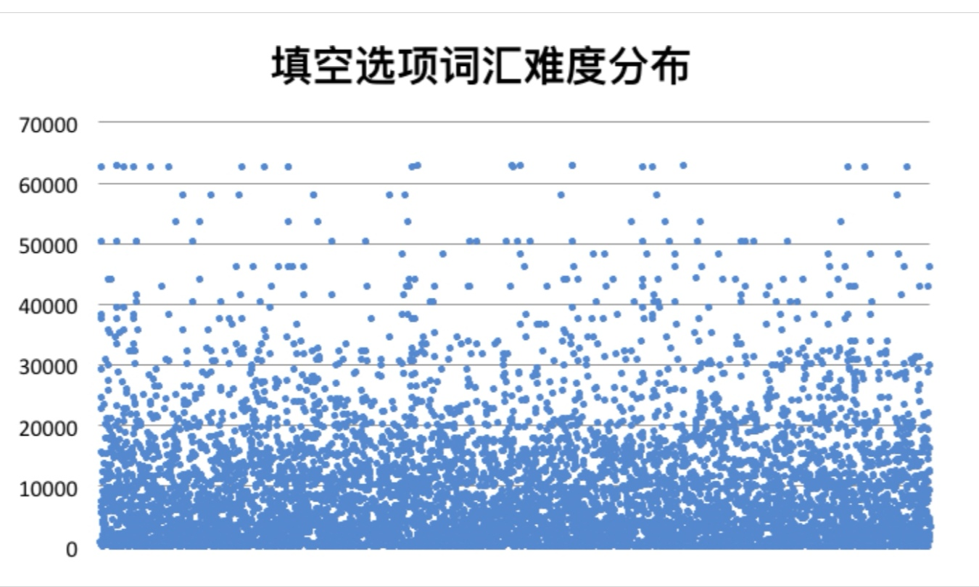

Slide 26
GRE填空中最难的词汇：
生僻度为“63145”
平均难度为“8963”

Slide 27
以此数据统计池为标准计算：
排位在
80%的GRE词汇生僻度为“15541”
98%的GRE词汇生僻度为“40406”
结论：
准备GRE考试， 需要15541的词汇量
对于GRE考神， 需要40406的词汇量

Slide 28
20000左右的GRE单词怎么搞？
背单词---认单词

Slide 29
In parts of the Arctic, the land grades into the landfast ice so ______ that you can walk off the coast and not know you are over the hidden sea.
(A) resurrectedly
(B) imperceptibly
(C) irregularly
(D) precariously
(E) relentlessly

Slide 30
The current (i) ______ of format in electronic scholarly publication will not last beyond the point when amateur burnout occurs and amateurs are replaced by traditional publishing companies: in an effort to reduce costs through economies of scale, publishing firms tend toward (ii) _____ in the format of their electronic publication projects.
Blank (i) Blank (ii)
(A) diversity (D) homogeneity
(B) monotony (E) commonplace
(C) refinement (F) complex
（PPII, Practice Test 2, V1, Medium, #3）

Slide 31
做题错误逻辑：1.xxxxxxxxxxxxx_____xxxxxxxxx_______xxxxx.
A.
B.
C.
D.
E.
信息分类：

Slide 32
冒号题：

Slide 33
1.In the 1950s, the country’s inhabitants were ______: most of them knew very little about foreign countries.
(A)partisan
(B)erudite
(C)insular
(D)cosmopolitan
(E)imperturbable
（PPII, Practice Test 1, V2, Easy, #1）

Slide 34
2.Economic competition among nations may lead to new forms of economic protectionism that hearken back to the mercantilism of an earlier age: there are signs today that such protectionism is indeed ______.
(A)evanescent
(B)resurgent
(C)recrudescent
(D)transitory
(E)controversial
(F)inimical
（PPII, Practice Test 1, V2, Hard, #15）

Slide 35
3.That the book’s argument was ______ became clear as soon as reviews appeared: there were holes, and reviewers delighted in pointing them out.
(A)wanting
(B)convoluted
(C)unintelligible
(D)penetrating
(E)flawed
(F)complex
（PPII, Practice Test 2, V2, Hard, #12）

Slide 36
4.The (i) _____ nature of classical tragedy in Athens belies the modern image of tragedy: in the modern view tragedy is austere and stripped down, its representations of ideological and emotional conflicts so superbly compressed that there’s nothing (ii) ______ for time to erode.
Blank (i) Blank (ii)
(A) unadorned (D) inalienable
(B) harmonious (E) exigent
(C) multifaceted (F) extraneous
（PPII, Practice Test 1, V2, hard, #3）

Slide 37
5.The current (i) ______ of format in electronic scholarly publication will not last beyond the point when amateur burnout occurs and amateurs are replaced by traditional publishing companies: in an effort to reduce costs through economies of scale, publishing firms tend toward (ii) _____ in the format of their electronic publication projects.
Blank (i) Blank (ii)
(A) diversity (D) homogeneity
(B) monotony (E) commonplace
(C) refinement (F) complex
（PPII, Practice Test 2, V1, Medium, #3）

Slide 38
二：分号题
分号表示 “并列”逻辑关系，就是冒号题的变型，前后两句取同。
但要注意是否跟着 although, however 等 “转折” 词，若有，则前后是 “转折” 关系

Slide 39
1.There are no solitary, free-living creatures; every form of life is______other forms.
(A) segregated from
(B) parallel to
(C) dependent on
(D) overshadowed by
(E) mimicked by
（PPII, Practice Test 1, V2, Easy, #3）

Slide 40
2. In some cultures the essence of magic is its traditional integrity; it can be efficient only if it has been _____ without loss from primeval times to the present practitioner.
(A) conventionalized
(B) transgressed
(C) transmitted
(D) manipulated
(E) aggrandized
（PPII, Practice Test 2, V2, Hard, #14）

Slide 41
转折对比关系

Slide 42
But（但是），表转折关系
Yet（然而），表转折关系
Although（虽然、尽管），表转折关系
Though（虽然、尽管、可是），表转折关系
Even though（即使），表转折关系
Despite（尽管），表转折关系
In spite of（尽管，不管），表转折关系
However（然而），表转折关系

Slide 43
Whatever（无论怎样），表转折关系
Whereas（尽管，然而），表转折关系
Nevertheless（然而），表转折关系
Unlike（和…不同），表转折关系
Even if（即使），表转折关系
While（虽然），放在句首表转折关系
Regardless（不管，尽管，不顾）
on the other hand （另一方面），表示转折

Slide 44
but (yet)
1.Dreams are ______ in and of themselves, but, when combined with other data, they can tell us much about the dreamer.
(A)astonishing
(B)disordered
(C)harmless
(D)inscrutable
(E)revealing
(F)uninformative
（PPII, Practice Test 1, V2 ,Medium, #15)

Slide 45
2.By about age eight, children’s phonetic capacities are fully developed but still ______; thus children at that age can learn to speak a new language with a native speaker’s accent.
(A)plastic
(B)vestigial
(C)inarticulate
(D)unformed
(E)nascent
(F)malleable
（PPII, Practice Test 2, V2, Medium, #14）

Slide 46
3.Because we assume the (i) ______ of natural design, nature can often (ii) ______ us: as the Wright brothers noted, the birds initially misled them in almost every particular, but their Flyer eventually succeeded by being the least avian of the early flying machines.
Blank (i) Blank (ii)
(A) quirkiness (D) galvanize
(B) preeminence (E) befriend
(C) maladroitness (F) beguile
（PPII, Practice Test 2, V2, Hard, #4）

Slide 47
4.The newborn human infant is not a passive figure, nor an active one, but what might be called an actively______ one, eagerly attentive as it is to sights and sound.
A.adaptive
B.selective
C.inquisitive
D.receptive
E.intuitive

Slide 48
although (though)
1Although Ms.Brown found some of her duties to be _____, her supervision of forty workers was a considerable responsibility.
A.ambiguous
B.equivocal
C.menial
D.humble
E.inquisitive
F.mediocre
（PPII, Practice Test 2, V2, Hard, #2)

Slide 49
rather than
A rather B 而非，对立取反
rather 单独出现，修饰形容词，只起强调作用，而非取反

Slide 50
1.Rather than enhancing a country’s security, the successful development of nuclear weapons could serve at first to increase that country’s______ .
(A)boldness
(B)influence
(C)fragility
(D)responsibility
(E)moderation
(F)vulnerability

Slide 51
2.As late as 1891 a speaker assured his audience that since profitable farming was the result of natural ability rather than______ , an education in agriculture was______ .
Blank (i) Blank (ii)
(A) effort (D)useless
(B) luck (E) vital
(C) learning (F) intellectual

Slide 52
3.The success of science is due in great part to its emphasis on_____: the reliance on evidence rather than _____and the willingness to draw conclusions even when they conflict with traditional beliefs.
Blank (i) Blank (ii)
(A) conservatism (D)facts
(B) creativity (E) preconceptions
(C) objectivity (F) observation

Slide 53
despite (in spite of)
1.Despite the pride that the play’s characters take in their worldly-wise absence of illusions, they are not above a degree of unjustified ______.
(A)prevarication
(B)satisfaction
(C)self-flattery
(D)affectation
(E)narcissism
(F)indolence
(PPII, Practice Test 1, V2, Easy, #16)

Slide 54
on the other hand
1.It comes as no surprise that societies have codes of behavior; the character of the codes, on the other hand, can often be ______.
(A)predictable
(B)unexpected
(C)admirable
(D)explicit
(E)confusing
（OG, p. 86, #1, Medium）

Slide 55
even
1.Even in this business, where ______ is part of everyday life, a talent for lying is not something usually found on one’s resume.
(A)aspiration
(B)mendacity
(C)prevarication
(D)insensitivity
(E)baseness
(F)avarice
（PPII, Practice Test 1, V1, Medium, #15）

Slide 56
nevertheless, nonetheless, notwithstanding
1.Notwithstanding their ______ regarding other issues, township residents have consistently passed the board of education’s annual budget.
(A)accord
(B)indecision
(C)consensus
(D)disagreement
(E)divergence
(F)enthusiasm

Slide 57
In fact / actually
In reality

Slide 58
1.The report’s most significant weakness is its assumption that the phenomenon under study is______, when in reality it is limited to a specific geographic area.
(A)unusual
(B)exceptional
(C)ubiquitous
(D)absolute
(E)universal
(F)restricted
(PPII, Practice Test 2, V2, Medium, #13)

Slide 59
2.Early critics of Emily Dickson’s poetry mistook for simplemindedness the surface of artlessness that in fact she constructed with such ______.
(A)astonishment
(B)craft
(C)cunning
(D)innocence
(E)naivete
(F)vexation
(PPII, Practice Test 1, V1, Medium, #12)

Slide 60
far from
far from 字面上是 “离…还很远”，引申为“并非”，概念上= not，为转折逻辑词。

Slide 61
1.Far from viewing Jefferson as a skeptical but enlightened intellectual, historians of the 1960s have portrayed him as ______ thinker, eager to fill the young with his political orthodoxy while censoring ideas he did not like.
(A)an adventurous
(B)a doctrinaire
(C)an eclectic
(D)a judicious
(E)a cynical
（PPII, Practice Test 1, V2, Medium, #2 (Hard, #1)

Slide 62
2.The vegetation at Stone Mountain, the best known of the large rock masses known as monadnocks, is far from ______, having been decimated by the hiking traffic.
(A)blighted
(B)endangered
(C)picturesque
(D)pristine
(E)undisturbed
(F)vulnerable
（PPII, Practice Test 1, V2, Medium, #12）

Slide 63
3.Many artists believe that successful imitation, far from being symptomatic of a lack of_______, is the first step in learning to be creative.
(A)elegance
(B)resolution
(C)goodness
(D)originality
(E)sympathy
(F)imagination

Slide 64
4.Hampshire’s assertions, far from showing that we can_____ the ancient puzzles about objectivity, reveal the issue to be even more_____ than we had thought.
Blank (i) Blank (ii)
(A) admire (D) elusive
(B) dismiss (E) relevant
(C) adapt (F) unconventional

Slide 65
while
If emissions of heat-trapping gases continue to accumulate in the atmosphere at the current rate, Earth could experience global transformations, and while some of these changes might be _____ ,many could be downright disruptive.
A.catastrophic
B.calamitous
C.intolerable
D.irremediable
E.modest
F.unremarkable
（PPII, Practice Test 2, V2, Medium, #13）

Slide 66
paradoxical
1.The paradoxical aspect of the myths about Demeter, when we consider the predominant image of her as a tranquil and serene goddess, is her______ search for her daughter.
A.extended
B.agitated
C.frantic
D.comprehensive
E.motiveless
F.heartless

Slide 67
paradoxical
2.Whereas biologists must maintain a______attitude toward the subjects of their research, social scientists must, paradoxically, combine personal involvement scholarly .
A.scrupulous
B.disinterested
C.passive
D.detachment
E.abandon
F.passion

Slide 68
anything but (anything other than)

Slide 69
1.Only by ignoring decades of mismanagement and inefficiency could investors conclude that a fresh infusion of cash would provide anything other than a ______ solution to the company’s financial woes.
(A)complete
(B)fleeting
(C)momentary
(D)premature
(E)trivial
(F)total
(OG, p. 381, #1)

Slide 70
whatever
It has been argued that politics as ___________, whatever its transcendental claims, has always been the systematic organization of common hatreds.
A. a theory
B. an ideal
C. a practice
D. a contest
E. an enigma

Slide 71
contradict to/by
The Neoplatonists' conception of a deity, in which perfection was measured by abundant fecundity, was contradicted by that of the Aristotelians, in which perfection was displayed in the ______ of creation.
A．profusion
B．precision
C．variety
D. clarity
E．economy

Slide 72
in contrast to
The children’s _____ natures were in sharp contrast to the even-tempered dispositions of their parents.
(A) blithe
(B) mercurial
(C) phlegmatic
(D) introverted
(E) artless
(F)inconstant

Slide 73
短语
Her ______ should not be confused with miserliness; as long as I have known her, she has always been willing to assist those who are in need.
(A)stinginess
(B)diffidence
(C)frugality
(D)illiberality
(E)intolerance
(F)thrift
（OG, p. 89, #7, Medium）

Slide 74
时间对比：
时间相反，产生对立：肯定现在，否定过去；
肯定将来，否定现在，而且往往两两配对出现

Slide 75
Before（之前），与later, recent对立
Recent（现在），与previous, pristine对立
Usually（过去通常），与recent对立
Early（早期的），与recent对立
Previous（早先的），与recent对立
Once（曾经）与after对立
Initially（起初）与after对立

Slide 76
Formerly（以前），与now对立
erstwhile：（从前的）
onetime：（曾经的）
First（起初），与now对立
Until（直到…才，除非），与before对立
No longer（不再），与before对立
Now（现在），与before对立

Slide 77
1.Often the difficulties of growing up in the public eye cause child prodigies to_____ the world of achievement before reaching adulthood: happily, they sometimes later return to competition and succeed brilliantly.
(A)ridicule
(B)conquer
(C)retire from
(D)antagonize
(E)examine

Slide 78
Although the passage of years has softened the initially hostile reaction to his poetry, even now only a few independent observers_______his works.
(A)praise
(B)revile
(C)merit
(D)scrutinize
(E)criticize
(F)neglect

Slide 79
At first, I found her gravity rather intimidating ;but, as I saw more of her, I found that____was very near the surface.
(A)seriousness
(B)confidence
(C)laughter
(D)poise
(E)determination

Slide 80
同义因果

Slide 81
Because（因为），表因果
In that（既然，因为），表因果
So that，表因果
Therefore, thereby（因此），表因果
Thus（因而，从而），表因果
Since A, B（既然A，因此B），表因果
Deduce（推论出），表因果
A result from B = A result of B（B导致A），表因果
As a result（作为结果），表因果

Slide 82
A lead to B（A导致B），表因果
Just as A, so B（正如A，所以B），表因果
Consequently（从而，因此），表因果
Given（因为…所以给出），表因果
Bespeak（说明），表因果
Portray（描绘），表弱因果
Conclude（得出结论），表因果
So A as to B（如此A以致于B），表因果
For（因为），表因果

Slide 83
Because
He was widely regarded as a_____man because he revealed daily his distrust of human nature and human motives.
(A)disrespectful
(B)cynical
(C)hedonistic
(D)misinformed
(E)fanatical

Slide 84
In that 因果关系

Slide 85
Dramatic literature often ______ the history of a culture in that it takes as its subject matter the important events that have shaped and guided the culture.
(A)confounds
(B)repudiates
(C)recapitulates
(D)anticipates
(E)polarizes
（PPII, Practice Test 1, V1, Medium, #1）

Slide 86
since 因果关系

Slide 87
1.Since she believed him to be both candid and trustworthy, she refused to consider the possibility that his statement had been ______.
(A)irrelevant
(B)facetious
(C)mistaken
(D)critical
(E)insincere
(PPII, Practice Test 1, V1, Medium, #2)

Slide 88
so that

Slide 89
1.In parts of the Arctic, the land grades into the landfast ice so ______ that you can walk off the coast and not know you are over the hidden sea.
A．permanently
B．imperceptibly
C．irregularly
D．precariously
E. relentlessly
（PPII, Test Preview, #6）

Slide 90
2.The Parisian Ecole des Beaux-Arts (School of Fine Arts) was (i) ______ many nineteenth- and twentieth-century artists, so that by 1930 the associated term “academic art” had become a (ii) ______.
Blank (i) Blank (ii)
(A) influential among (D) pejorative
(B) ridiculed by (E) conundrum
(C) attended by (F) misnomer
（PPII, Practice Test2 V2 Hard #3）

Slide 91
lead to
The detective`s conviction that there were few inept crimes in her district led her to impute some degree of _____ to every suspect she studied.
A.deceit
B.acumen
C.duplicity
D.shrewdness
E.evasiveness
F.equivocation
（PPII, Practice Test2 V2 Hard #3）

Slide 92
同义并列&递进

Slide 93
Not only A but also B（不仅仅是A，而且B），表递进
When（当），表递进
Indeed（甚至），表递进
Even（甚至），表递进，但是even连接句子、放在句首是让步
Continue（继续、持续），表递进
Remain, retain（继续，持续），表递进（转折之前的状态的持续）
As…as（既…又），表递进
As long as（只要，随着），表递进
Particularity, especially（尤其是），表递进
And（并且），表递进
likewise（同样的），表并列递进

Slide 94
likewise
Ever a demanding reader of the fiction of others, the novelist Chase was likewise often the object of_____analyses by his contemporaries.
A. exacting
B. copious
C. respectful
D. ascerbic
E. scathing
F. meticulous
（OG, P88, Medium #6）

Slide 95
when
The government’s implementation of a new code of ethics appeared intended to shore up the ruling party’s standing with an increasingly _________ electorate at a time when the party is besieged by charges that it trades favors for campaign money.
A. aloof
B. placid
C. restive
D. skittish
E. tranquil
F. vociferous
（OG, P99, Hard #7）

Slide 96
三空题

Slide 97
三空题
1. 单空题+双空题
2. 三个单空题

Slide 98
1. The myth persists that in 1492 the Western Hemisphere was a (i)___ and that it was European settlers who harnessed and transformed its ecosystems. But scholarship shows that forests, in particular, had been altered to varying degrees well before the arrival of Europeans. Native populations had (ii)___ much of the forests to successfully cultivated stands, especially by means of burning. Nevertheless, some researchers have maintained that the extent, frequency, and impact of such burning was (iii)___.
Blank (i) Blank (ii) Blank (iii)
(A) wilderness (D) hesitated (G) superfluous
(B) demonstration (E) underestimated (H) considerable
(C) redundancy (F) converted (I) minimal

Slide 99
2. Burning also converted mixed stands of trees to (i)___ forest, for example the longleaf, slash pine, and scrub oak forests of the southeastern U.S. Natural fires do account for some of this vegetation, but regular burning clearly (ii)___ it. Burning also influenced forest composition in the tropics, where natural fires are rare. An example is the pine-dominant forests of Nicaragua, where warm temperatures and heavy rainfall naturally favor (iii)___ tropical or rain forests. While there are primarily grow in cooler, drier, higher elevations, regions where such vegetation is in large part are natural and even prehuman.
Blank (i) Blank (ii) Blank (iii)
(A) presumptuous (D) meditated (G)controversial
(B) contentious (E) dismissed (H) efficacious
(C) homogeneous (F) extended (I) motley

Slide 100
3. In contrast, some critics maintain that whatever authority judicial pronouncements have is exclusively institutional. Some of these critics go further, claiming that intellectual authority does not really exist—i.e., it reduces to institutional authority. But it can be (i)___ that these claims break down when a sufficiently broad historical perspective is taken: Not all arguments accepted by institutions withstand the test of time, and some well-reasoned arguments never receive institutional (ii)___. The reasonable argument that goes unrecognized in its own time because it (iii)___ institutional beliefs is common in intellectual history; intellectual authority and institutional consensus are not the same thing.
Blank (i) Blank (ii) Blank (iii)
(A) countered (D) predictability (G) revised
(B) emulated (E) imprimatur (H) challenges
(C) appreciated (F) accumulation (I) delimited

Slide 101
4. While right-to-work laws may not “destroy” unions by (i)___ the absolute number of unionized workers, they do (ii)___ the spread of unions and thereby (iii)___ wages within right-to-work states.
Blank (i) Blank (ii) Blank (iii)
(A) abating (D) precipitate (G) underprice
(B) inflating (E) delay (H) reduce
(C) downgrading (F) impede (I) blow up

Slide 102
5. Among the factors that (i)___ the competitiveness of integrated producers are excessive labor, energy, and capital costs, as well as manufacturing (ii)___: their equipment is old and less automated, and does not (iii)___ many of the latest refinement in steelmaking technology.
Blank (i) Blank (ii) Blank (iii)
(A) incorporate (D) inflexibility (G) amalgamate
(B) constrain (E) stability (H) intertwine
(C) are peripheral to (F) tradition (I) incorporate

Slide 103
6. Nonprofessional women are concentrated in secretarial work and department store sales, where their (i)___ can be covered easily by substitutes and where they can enter and leave the work force with (ii)___ loss, since the jobs offer so little personal gain: indeed, as long as family roles continue to be allocated on the basis of gender, women will be seriously (iii)___ in that labor market.
Blank (i) Blank (ii) Blank (iii)
(A) absences (D) consequential (G) privileged
(B) salaries (E) material (H) insolvent
(C) sufferings (F) minute (I) disadvantaged

Slide 104
综合演练

Slide 105
(OG Verbal Practice Set 1 Q7, Easy)
The judge’s standing in the legal community, though shaken by phony allegations of wrongdoing, emerged, at long last, _______.
(A) unqualified
(B) undiminished
(C) undecided
(D) undamaged
(E) unresolved
(F) unprincipled

Slide 106
(OG Verbal Practice Set 1 Q8, Easy)
Modern agricultural practices have been extremely successful in increasing the productivity of major food crops, yet despite heavy use of pesticides, ______ losses to diseases and pests are sustained each year.
(A) incongruous
(B) reasonable
(C) significant
(D) considerable
(E) equitable
(F) fortuitous

Slide 107
(OG Verbal Practice Set 3 Q1, Medium)
It comes as no surprise that societies have codes of behavior; the character of the codes, on the other hand, can often be _______.
(A) predictable
(B) unexpected
(C) admirable
(D) explicit
(E) confusing

Slide 108
(OG Verbal Practice Set 3 Q2, Medium)
Like Béla Bartók, Ruth Crawford not only brought a composer’s acumen to the notation of folk music, she also had a marked (i) _______ the task. This was clear in her agonizing over how far to try to represent the minute details of a performance in a written text, and this (ii) ______ makes her work a landmark in ethnomusicology.
Blank (i) Blank (ii)
(A) reverence for (D) fastidiousness
(B) detachment from (E) didacticism
(C) curiosity about (F) iconoclasm

Slide 109
(OG Verbal Practice Set 3 Q3, Medium)
Political advertising may well be the most (i) ______ kind of advertising: political candidates are usually quite (ii)______, yet their campaign advertisements often hide important differences behind smoke screens of smiles and empty slogans.
Blank (i) Blank (ii)
(A) polemical (D) interchangeable
(B) effective (E) dissimilar
(C) deceptive (F) vocal

Slide 110
(OG Verbal Practice Set 3 Q7, Medium)
Her ______ should not be confused with miserliness; as long as I have known her, she has always been willing to assist those who are in need.
(A) stinginess
(B) diffidence
(C) frugality
(D) illiberality
(E) intolerance
(F) thrift

Slide 111
(OG Verbal Practice Set 5 Q1, Hard)
For some time now, ______ has been presumed not to exist: the cynical conviction that everybody has an angle is considered wisdom.
(A) rationality
(B) flexibility
(C) diffidence
(D) disinterestedness
(E) insincerity

Slide 112
(OG Verbal Practice Set 5 Q7, Hard)
The government’s implementation of a new code of ethics appeared intended to shore up the ruling party’s standing with an increasingly ______ electorate at a time when the party is besieged by charges that it trades favors for campaign money.
(A) aloof
(B) placid
(C) restive
(D) skittish
(E) tranquil
(F) vociferous

Slide 113
(OG Authentic GRE Practice Test Section 3, Q6)
The reception given to Kimura’s radical theory of molecular evolution shows that when ______ fights orthodoxy to a draw, then novelty has seized a good chunk of space from convention.
(A) imitation
(B) reaction
(C) dogmatism
(D) invention
(E) caution

Slide 114
(OG Authentic GRE Practice Test Section 3, Q7)
The (i) ______ of Vladimir Nabokov as one of North America’s literary giants has thrown the spotlight on his peripheral activities and has thus served to (ii) ______ his efforts as an amateur entomologist.
Blank (i) Blank (ii)
(A) stigmatization (D) foregrounded
(B) lionization (E) transcend
(C) marginalization (F) obscure

Slide 115
(OG Authentic GRE Practice Test Section 3, Q8)
Mathematicians have a distinctive sense of beauty: they strive to present their ideas and results in a clear and compelling fashion, dictated by ______ as well as by logic.
(A) caprice
(B) aesthetics
(C) obligation
(D) methodologies
(E) intellect

Slide 116
(OG Authentic GRE Practice Test Section 3, Q21)
The plan, which the engineers said would save the aquifer by reducing pumping to ______ levels, has passed a governmental environmental review but faces opposition from outdoor and environmental groups.
(A) innocuous
(B) feasible
(C) practicable
(D) minimal
(E) remedial
(F) benign

Slide 117
(OG Authentic GRE Practice Test Section 3, Q22)
Though feminist in its implication, Yvonne Rainer’s 1974 film ______ the filmmaker’s active involvement in feminist politics.
(A) antedated
(B) cloaked
(C) portrayed
(D) preceded
(E) renewed
(F) represented

Slide 118
(OG Authentic GRE Practice Test Section 3, Q23)
Congress is having great difficulty developing a consensus on energy policy, primarily because the policy objectives of various members of Congress rest on such ______ assumptions.
(A) commonplace
(B) disparate
(C) divergent
(D) fundamental
(E) trite
(F) trivial

Slide 119
(OG Authentic GRE Practice Test Section 4, Q2)
Some scientists argue that carbon compounds play such a central role in life on Earth because of the possibility of ______ resulting from the carbon atom’s ability to form an unending series of different molecules.
(A) diversity
(B) deviation
(C) variety
(D) reproduction
(E) stability
(F) invigoration

Slide 120
其他题型
do A by doing B

Slide 121
Roman historians who study the period 30 B.C. to A.D. 180 can _____ the “Augustan peace” only by failing to recognize that this peace in many respects resembled that of death.
(A) decry
(B) applaud
(C) ridicule
(D) demand
(E) disprove

Slide 122
In an age without radio or recordings, an age______ by print, fiction gained its greatest ascendancy.
(A) decimated
(B) denigrated
(C) dominated
(D) punctuated
(E) resurrected

Slide 123
Edith Wharton sought in her memoir to present herself as having achieved a harmonious wholeness by having______the conflicting elements of her life.
(A) affirmed
(B) reconciled
(C) highlighted
(D) resolved
(E) identified
(F) confined

Slide 124
双 of 结构
xxxx N1 of N2 xxxx N1'of N2' xxxx
结论：N1=N1'
N2=N2'

Slide 125
Some scientists argue that carbon compounds play such a central role in life on Earth because of the possibility of______resulting from the carbon atom’s ability to form an unending series of different molecules.
(A) diversity
(B) deviation
(C) variety
(D) reproduction
(E) stability
(F) invigoration

Slide 126
The sheer diversity of tropical plants represents a seemingly______source of raw materials, of which only a few have been utilized.
(A) exploited
(B) quantifiable
(C) controversial
(D) inexhaustible
(E) remarkable
(F) infinite

Slide 127
Scholars’ sense of the uniqueness of the central concept of “the state” at the time when political science became an academic field quite naturally led to striving for a correspondingly______mode of study.
(A) thorough
(B) distinctive
(C) dependable
(D) scientific
(E) mundane

Slide 128
It is his dubious distinction to have proved what nobody would think of denying, that Romero at the age of sixty-four writes with all the characteristics of______.
(A) maturity
(B) fiction
(C) inventiveness
(D) art
(E) brilliance
(F) ripeness
(E) mundane

