Slide 1
机器学习与量化交易实战
第九课

Slide 20
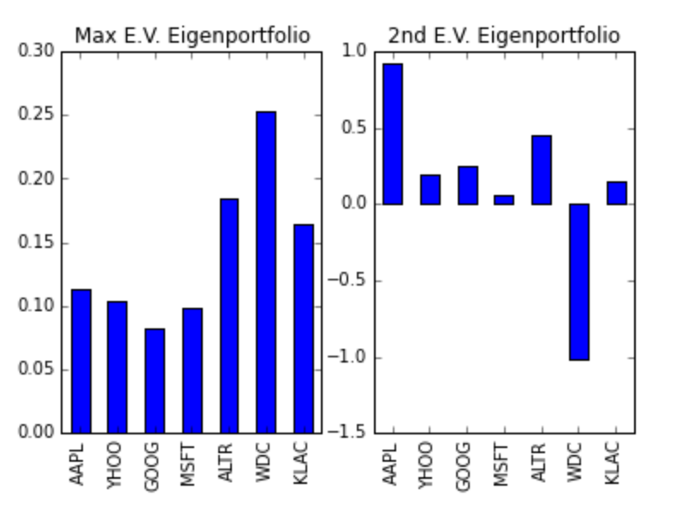

Slide 21
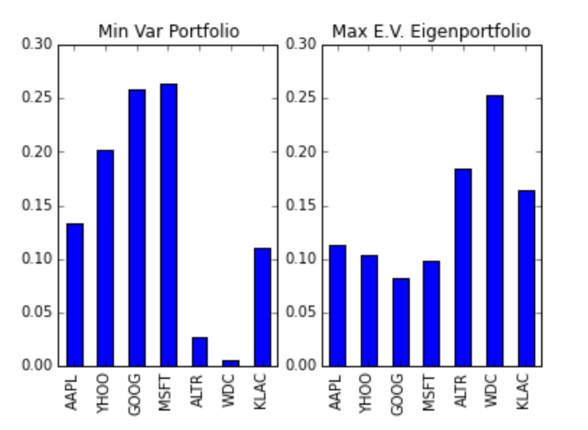

Slide 23
1603.08604v1.pdf
The overall training dataset consists of the aggregate of feature training sets for each of the symbols. The training set of each symbol consists of price differences and engineered features including lagged prices diﬀerences from 1 to 100, moving price averages with window sizes from 5 to 100, and pair-wise correlations between the returns and the returns of all other symbols. The overall training set contains 9895 features. The motivation for including these features in the model is to capture memory in the historical data and co-movements between symbols

Slide 24
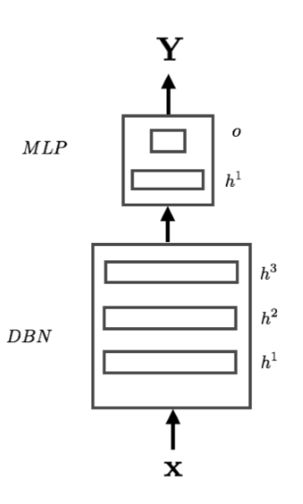
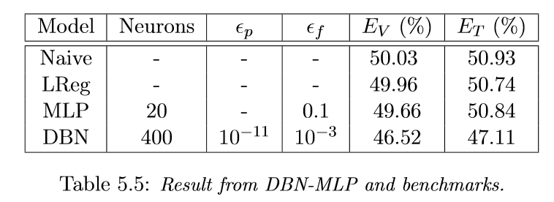
150612a.pdf Deep Learning for Multivariate Financial Time Series

Slide 25
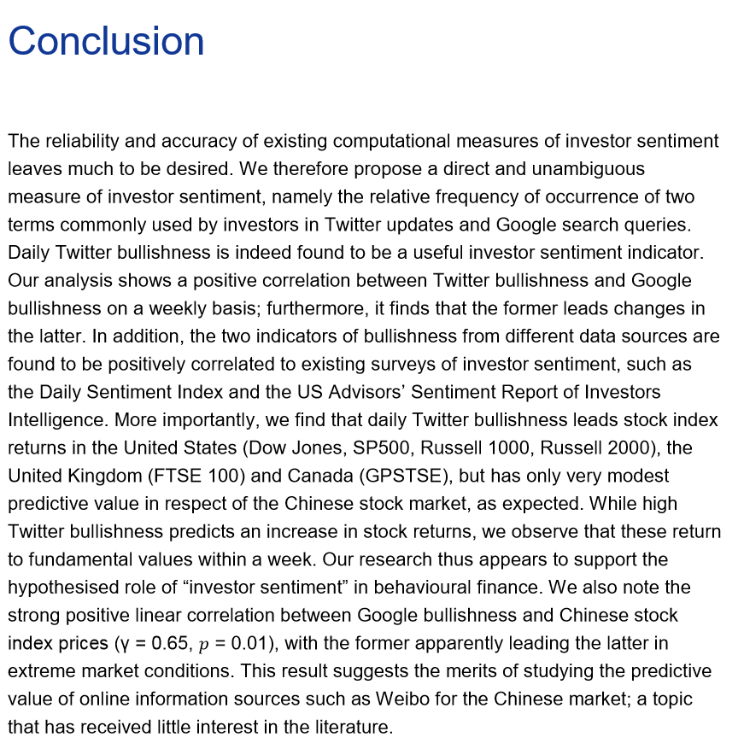
ecbsp9.en.pdf

Slide 26
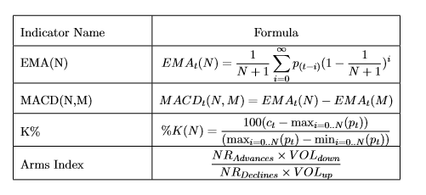
fora_gyula_krisztian.pdf

